Slide 1
Apps that make life easier
Tech Savvy Seniors
Module 9

Slide 2

Acknowledgement of Country
We recognise and acknowledge the existing, original, and ancient connection Aboriginal and Torres Strait Islander peoples have to the lands, waterways, and sky country across the Australian continent. We pay our respects to their Elders past and present.
Artwork: 'Connection' by Bobbi Lockyer.

Slide 3





Learning outcomes
By the end of this session, you’ll be able to:
Explain what an app is and the different types of apps available.
Search for and download apps.
Use apps to access services and manage accounts.
Manage app settings such as updates, permissions, and notifications.
Organise and delete apps.

Slide 4

Have you used any apps before? Which ones?

Slide 5
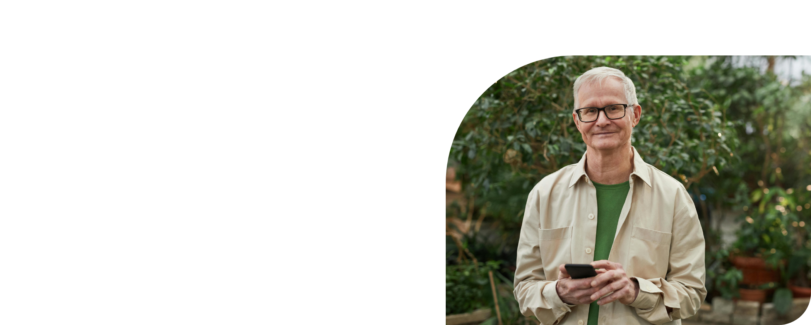
What’s one thing you’d like to feel more confident about by the end of today?

Slide 6







What is an app?
Opal
Transit
Service NSW
myGov
My Telstra
Hazards Near Me NSW
my health

Slide 7


Downloading apps
App Store
for Apple
Google Play Store
for Android

Slide 8
Opal Travel App
Check your card balance
View your trip history
Plan a journey and view estimated fares
Top up your card with a debit/credit card

Slide 9
Transit App
View real-time public transport timetables across NSW
Plan a trip
Use GO for step-by-step directions and notifications
View service alerts

Slide 10

Transit App
Watch
Notes:
https://youtu.be/yzjTc2V4_Ew?si=tqhvoWXEHWYzw-B7

Slide 11
Service NSW App
Digital licences
Vehicle registration checks and renewal
Fines and demerits
Vouchers
Seniors/Senior Savers Card

Slide 12
myGov App
Medicare
Centrelink
Australian Taxation Office (ATO)
My Health Record
National Disability Insurance Scheme (NDIS)

Slide 13

myGov App
Watch

Slide 14
My Telstra App
Check your mobile or internet usage
View and paying bills
Track orders or service outages
Contact customer support

Slide 15
Hazards Near Me NSW App
Replaces ‘Fires Near Me’ app
Real-time bushfire warnings and other emergency alerts in your local area
Set ‘Watch Zones’
Receive push notifications

Slide 16
my health App
Connects directly to your My Health Record
View your:
Medications and prescriptions
Immunisations
Pathology and imaging results
Hospital discharge summaries
Allergies and adverse reactions

Slide 17
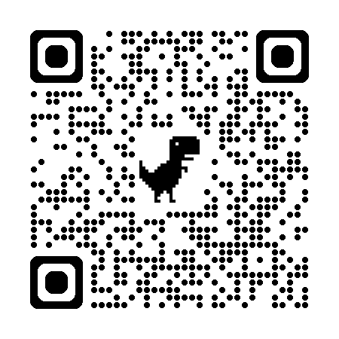
Get ePrepared
Helps you prepare electronic copies of your essential documents - to prove who you are, where you live, or what you own - in case of an emergency.

Slide 18

Let’s spend time on your questions from the start of the session.

Slide 19
Learning outcomes
I can:
Explain what an app is and the different types of apps available.
Search for and download apps.
Use apps to access services and manage accounts.
Manage app settings such as updates, permissions, and notifications.
Organise and delete apps.

Slide 20

What’s your key takeaway?

Slide 21

What three things will you try in the next week?

Slide 22
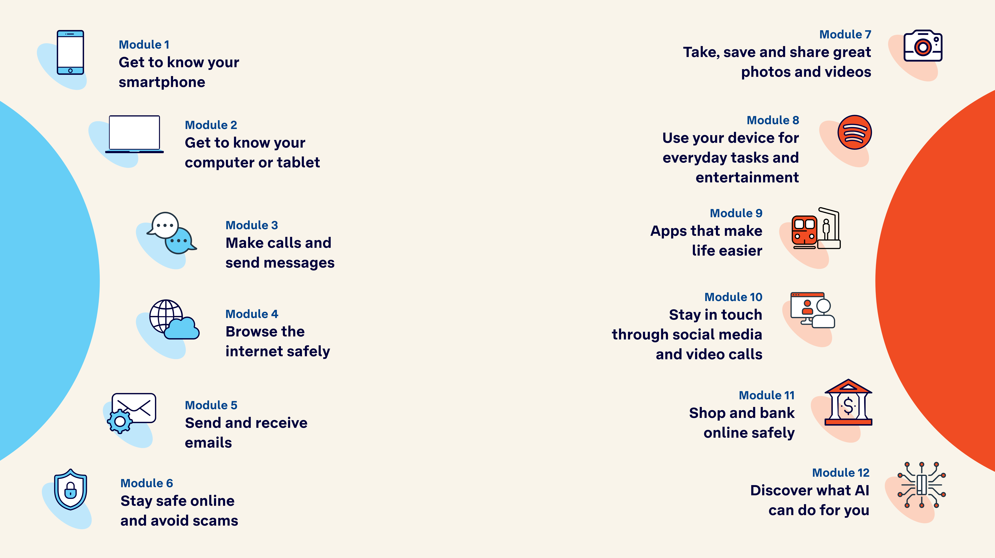
Tech Savvy
Seniors

