Slide 1
Use your device for everyday tasks and entertainment
Tech Savvy Seniors
Module 8

Slide 2

Acknowledgement of Country
We recognise and acknowledge the existing, original, and ancient connection Aboriginal and Torres Strait Islander peoples have to the lands, waterways, and sky country across the Australian continent. We pay our respects to their Elders past and present.
Artwork: 'Connection' by Bobbi Lockyer.

Slide 3



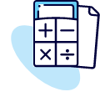

Learning outcomes
By the end of this session, you’ll be able to:
Download, open and close apps.
Use a navigation app to find a location and get directions.
Set an alarm, timer, reminder or calendar event.
Use a calculator, write a note and check the weather.
Try a video, music, podcast or game app.

Slide 4
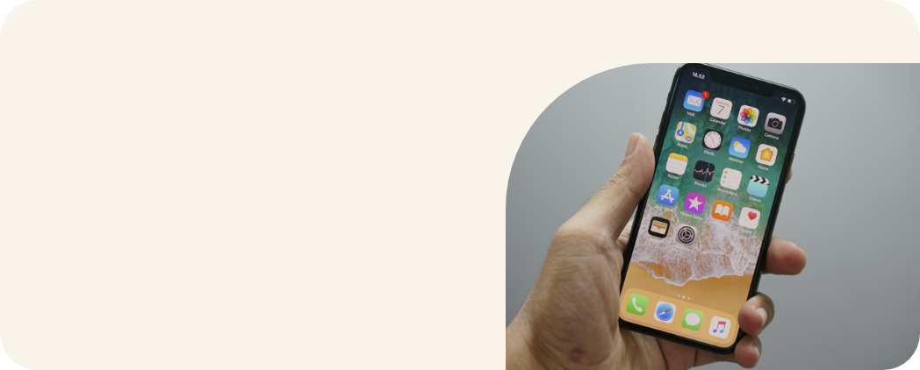
What are some things you already use your device for?

Slide 5

What’s something new or fun you’d like to try today?

Slide 6
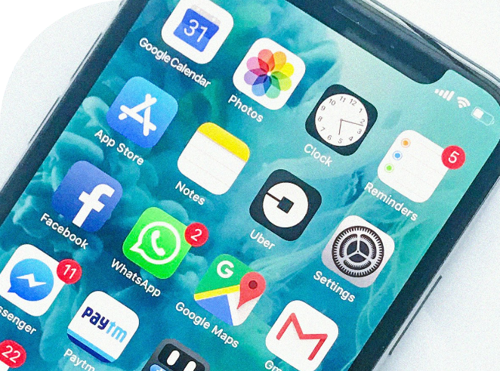
What is an app?
An application, a small program or tool on your device that helps you do something.
Some apps help with tasks (e.g. calculator) and others are for fun (e.g. games, videos).
Every app has its own icon (a little picture or logo) that you tap to open.
Some apps are already installed; others can be downloaded from the App Store (Apple) or Google Play Store (Android).

Slide 7
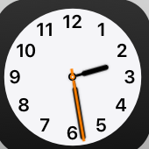
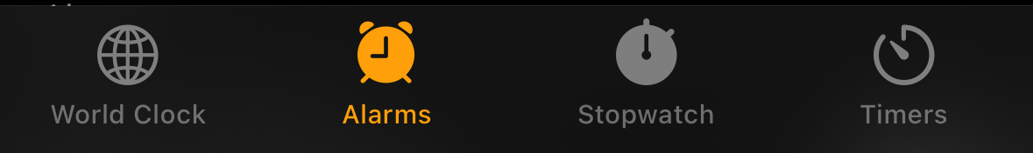
Clock

Slide 8
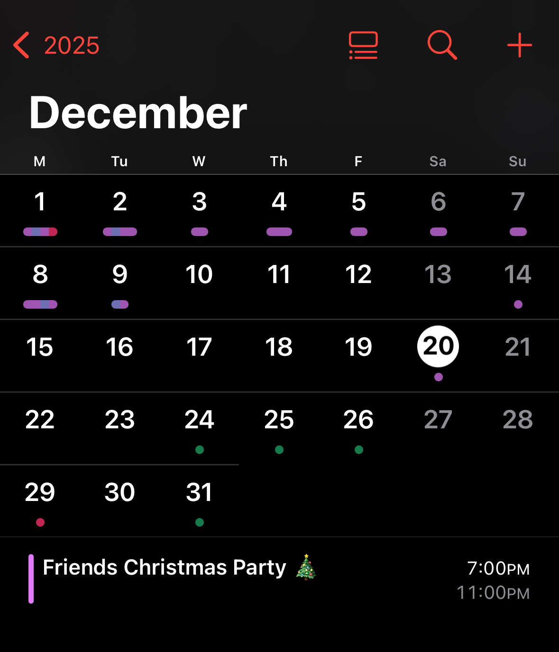
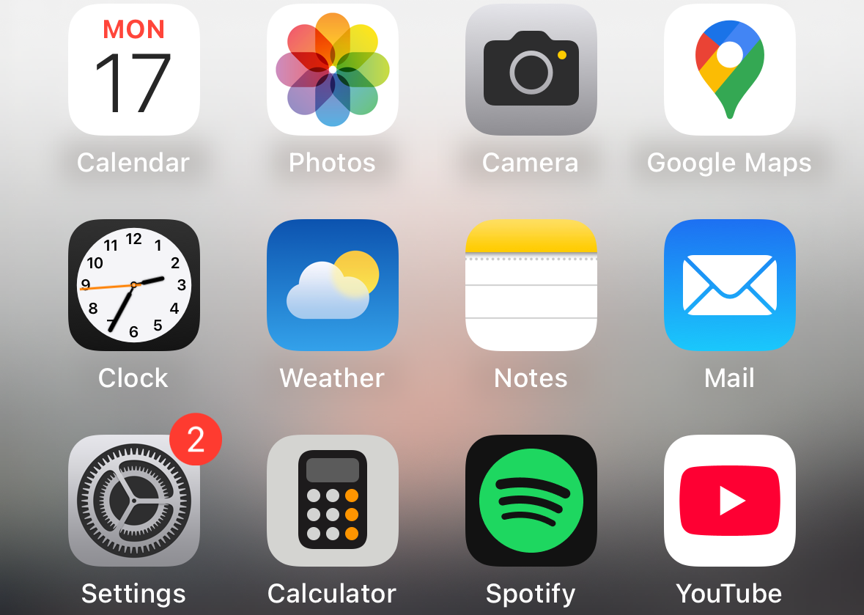
Calendar

Slide 9
Calculator, Notes, Weather

Slide 10
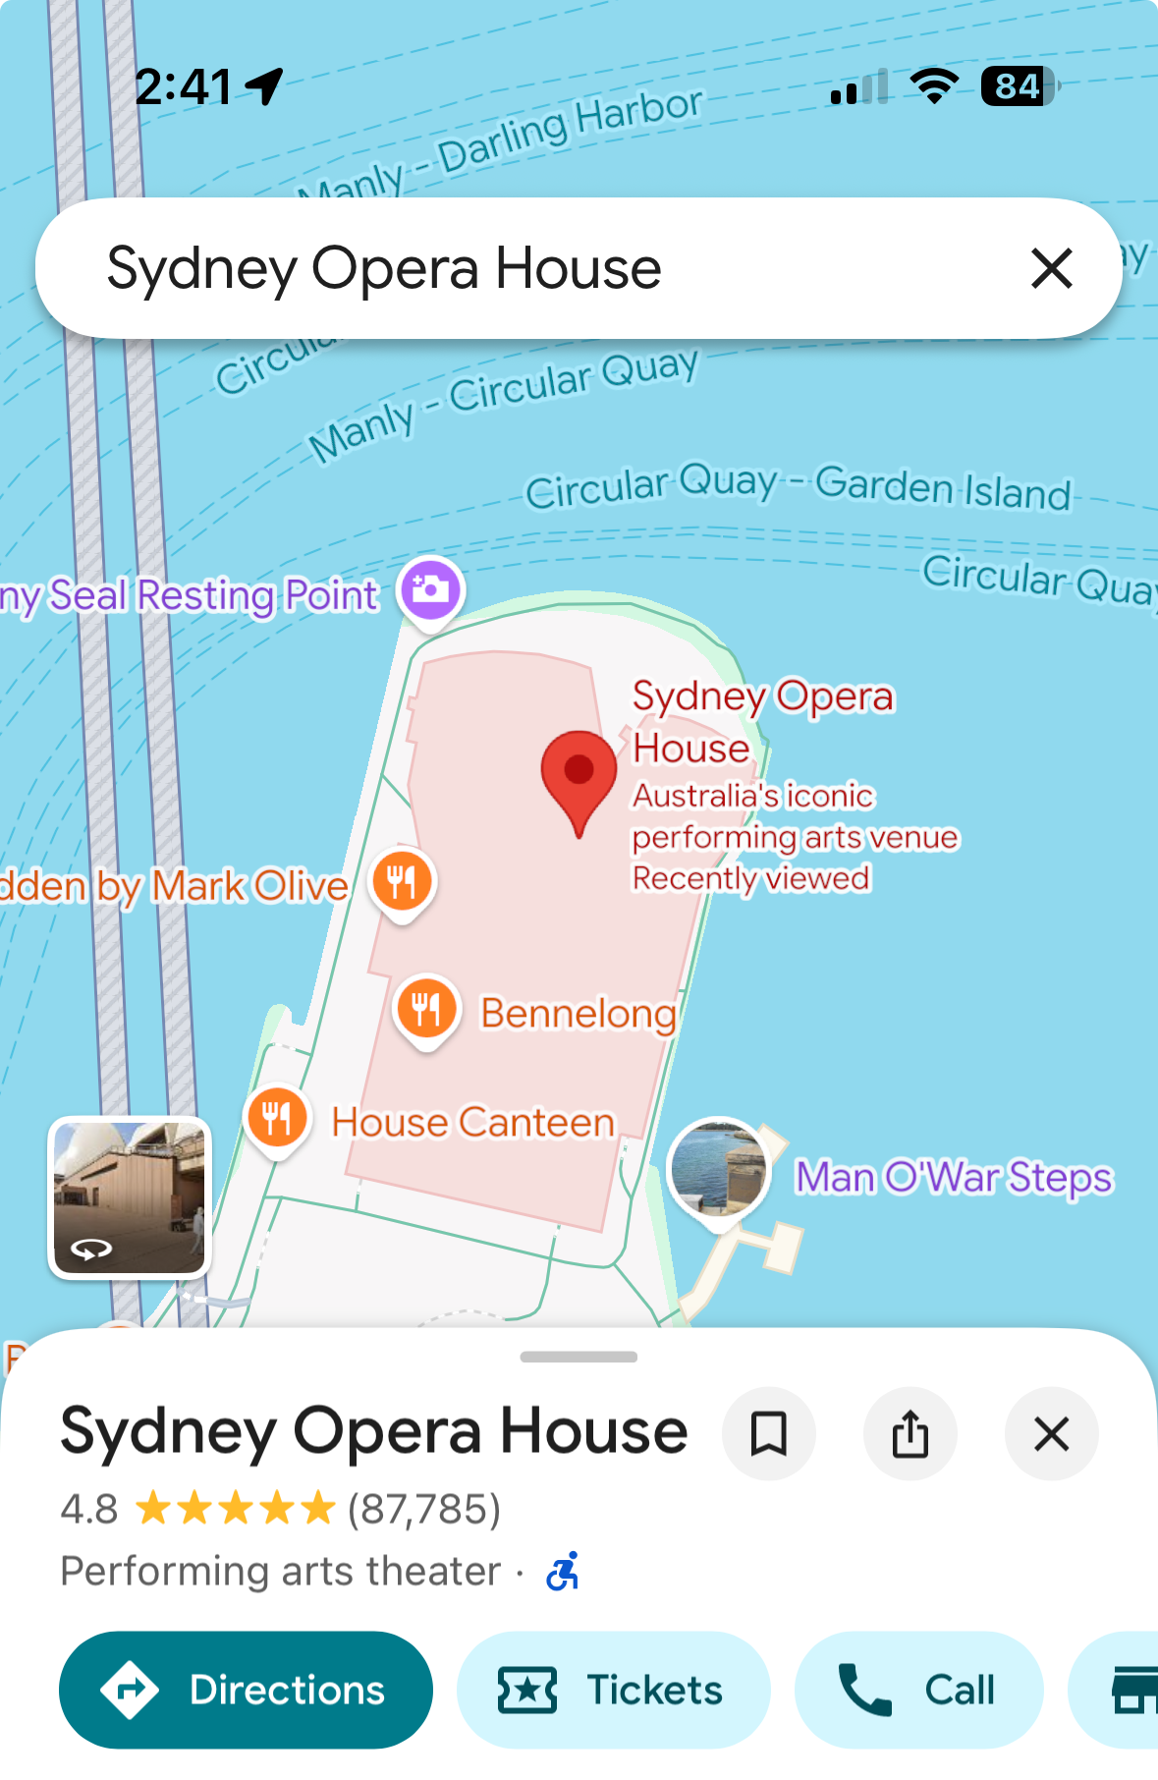

Google Maps

Slide 11




Entertainment on your device
Videos
Music
Podcasts
Games

Slide 12
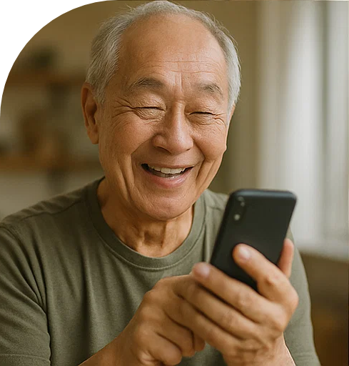
Let’s spend time on your questions from the start of the session.

Slide 13
Learning outcomes
I can:
Download, open and close apps.
Use a navigation app to find a location and get directions.
Set an alarm, timer, reminder or calendar event.
Use a calculator, write a note and check the weather.
Try a video, music, podcast or game app.

Slide 14

What’s your key takeaway?

Slide 15

What three things will you try in the next week?

Slide 16
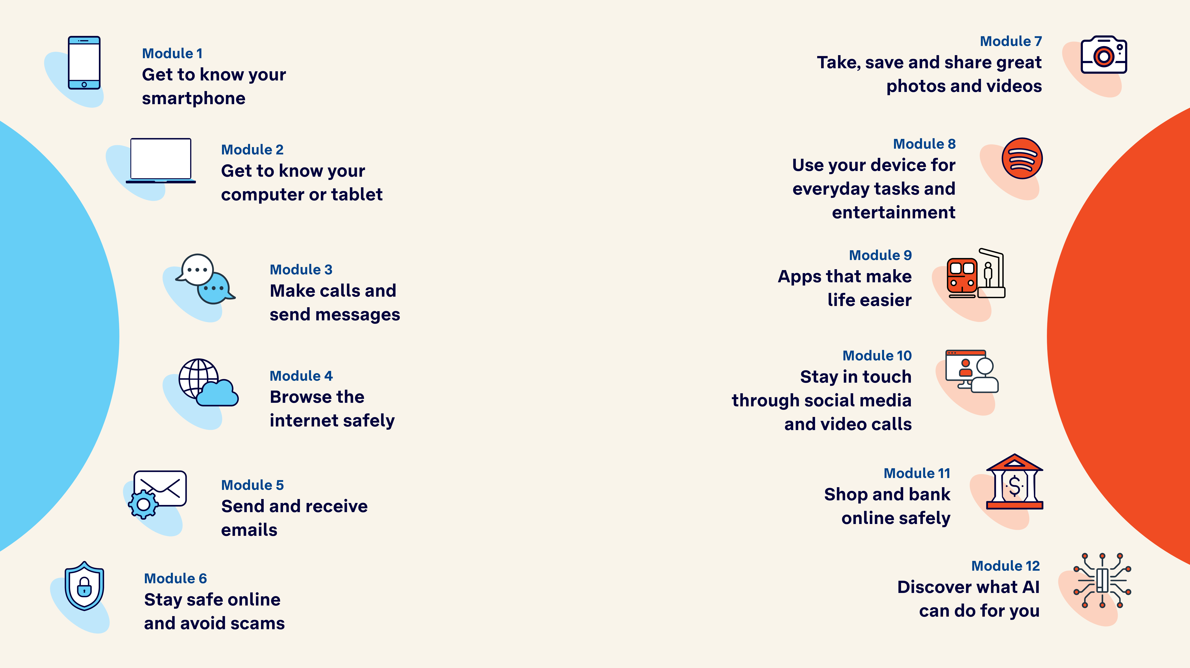
Tech Savvy
Seniors

