Slide 1







Tech Savvy Seniors
Module 8: Use your device for everyday tasks and entertainment
My notes
I can:
Download, open and close apps.
Use a navigation app to find a location and get directions.
Set an alarm, timer, reminder or calendar event.
Use a calculator, write a note and check the weather.
Try a video, music, podcast or game app
Key takeaways
My key insights from today are:
Support
I can get support from:
My action plan
In the next week, I will:
1
2
3

Slide 2


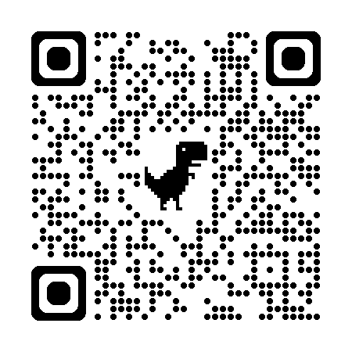
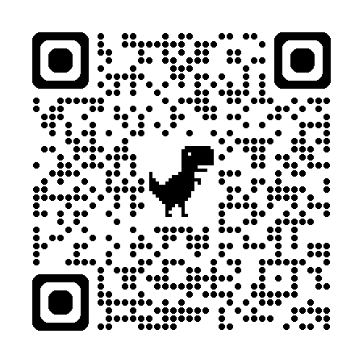
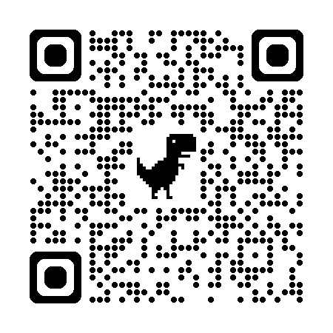
Tech Savvy Seniors
Module 8: Use your device for everyday tasks and entertainment
What are apps?
Apps are small programs on your phone or tablet that help you do things, like checking the weather or playing music.
Some apps come already installed. Others can be downloaded from the App Store (Apple) or Play Store (Android). They can be free or paid.
Helpful everyday tools
Most devices come with these built-in apps.
Clock App:
You can use the Clock app to:
  Set an alarm.
  Use a timer to count down (great for baking).
  Track time with the stopwatch.
  Check the time in different countries using the world clock.
Calendar & Reminders:
You can stay organised by:
  Adding events to the Calendar app.
  Creating tasks in the Reminders/Tasks app.
Weather App:
Check today’s temperature, weekly forecast or see the weather in other cities.
Calculator App:
Do sums or convert currencies and units.
Notes or Google Keep App:
Write to-do lists, keep reminders or save thoughts. You can also add photos, audio recordings, and web links. Some apps let you organise notes into folders.
Using maps for directions
Navigation apps like Google Maps let you:
  Search for an address, place or business.
  View details: opening hours, reviews, phone number, website.
  Get directions by walking, public transport or car.
  Save favourite places to a list or share a location with someone.
Entertainment
Your device is also a great way to relax, laugh or learn something new.
Video, Music and Podcasts
You can enjoy a wide range of entertainment using apps like:
  YouTube – Watch how-to videos, music clips, or old interviews.
  ABC Listen – Tune into podcasts and live radio.
  Spotify – Listen to music or podcasts (ads included in free version).
Some apps offer both free versions (with ads) and paid versions (ad-free with extra features).
Games:
Play games to relax or challenge your brain. Popular games include Solitaire, Wordscapes, Mahjong and Sudoku.
You can also play games with friends or family using apps like:
  Words With Friends
  UNO!™
  Draw Something
  Chess.com
To play together, both people need the app and may need to sign up.
User guide
Scan the QR codes (with your camera) or select the links.
iPhone apps
Tap Table of Contents > Apps to learn about iPhone inbuilt apps.
Google Maps
BeConnected
Useful apps
Learn more about apps.

