Slide 1
Take, save and share great photos and videos
Tech Savvy Seniors
Module 7

Slide 2

Acknowledgement of Country
We recognise and acknowledge the existing, original, and ancient connection Aboriginal and Torres Strait Islander peoples have to the lands, waterways, and sky country across the Australian continent. We pay our respects to their Elders past and present.
Artwork: 'Connection' by Bobbi Lockyer.

Slide 3





Learning outcomes
By the end of this session, you’ll be able to:
Open and use the camera to take photos and videos.
View, delete, and organise photos and videos.
Perform basic photo and video edits.
Share a photo or video by message or email.
Understand privacy considerations when sharing.

Slide 4

Who has taken a photo with their device before? Do you have any favourite things to take photos of?

Slide 5

What’s one thing you’d like to feel more confident about by the end of today?

Slide 6
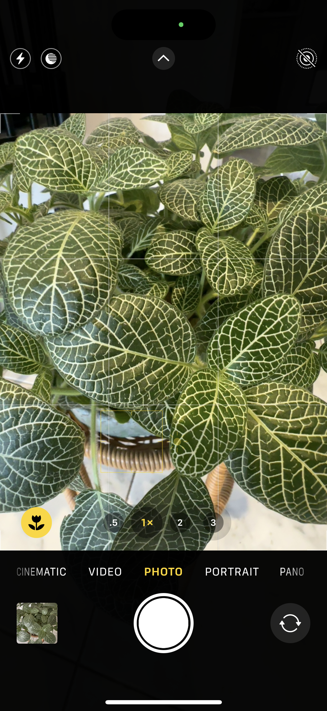
What is the camera app?
1
Flash: Tap to turn on/off
Mode: Tap to change modes
Preview thumbnail: Tap to view your last photo/video
Shutter button: Tap to take a photo/video (depending on mode)
Flip camera: Switch between front and rear camera
Zoom: Tap to zoom in/out
6
2
3
5
4

Slide 7


Orientation
Portrait
Landscape

Slide 8


View your photos and videos
iPhone
Google

Slide 9

Can you find your latest photo? Can you swipe through to see earlier photos?

Slide 10
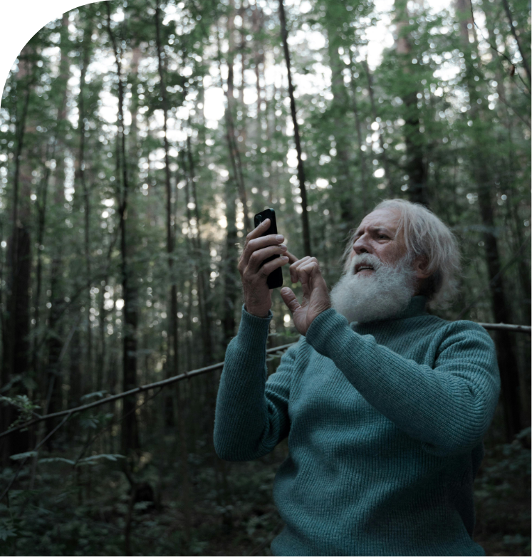
Let’s organise photos and videos into albums.

Slide 11

Delete unwanted photos and videos so they don't clutter your photo library or take up space.

Slide 12

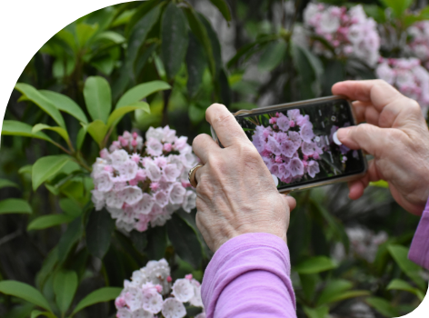
Share your photos and videos
One of the joys of taking photos is being able to share them with others.

Slide 13

Let’s spend time on your questions from the start of the session.

Slide 14
Learning outcomes
I can:
Open and use the camera to take photos and videos.
View, delete, and organise photos and videos.
Perform basic photo and video edits.
Share a photo or video by message or email.
Understand privacy considerations when sharing.

Slide 15

What’s your key takeaway?

Slide 16

What three things will you try in the next week?

Slide 17
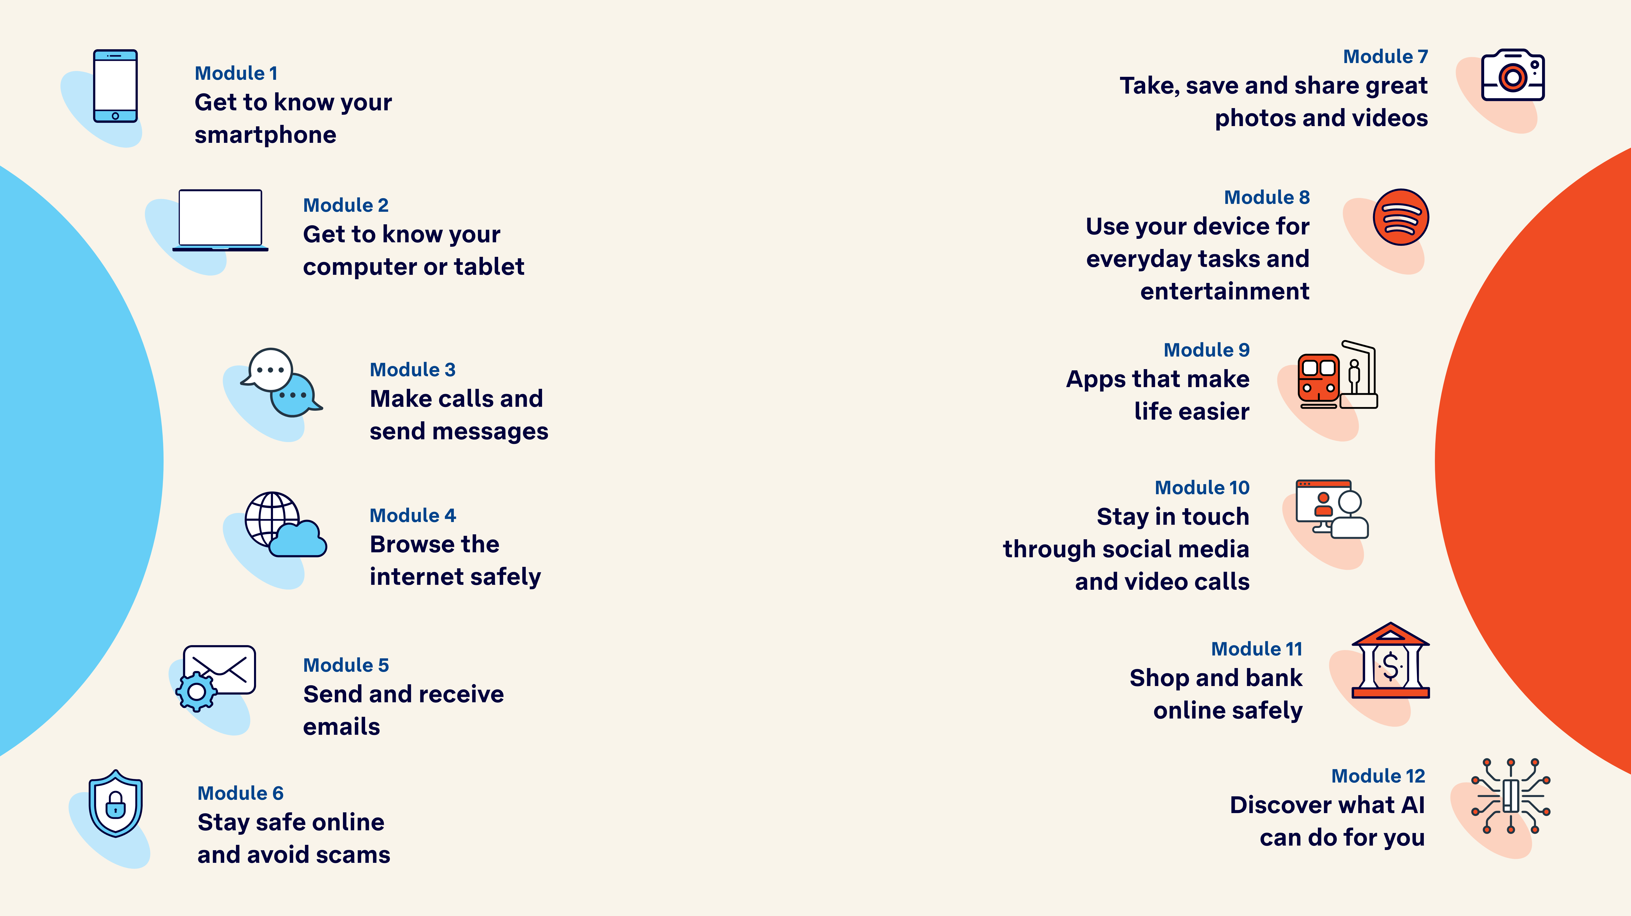
Tech Savvy
Seniors

