Slide 1







Tech Savvy Seniors
Module 7: Take, save and share great photos and videos
My notes
I can:
Open and use the camera to take photos and videos.
View, delete, and organise photos and videos.
Perform basic photo and video edits.
Share a photo or video by message or email.
Understand privacy considerations when sharing.
Key takeaways
My key insights from today are:
Support
I can get support from:
My action plan
In the next week, I will:
1
2
3

Slide 2



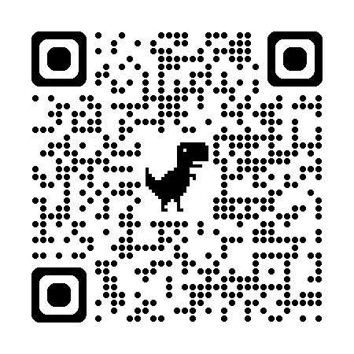
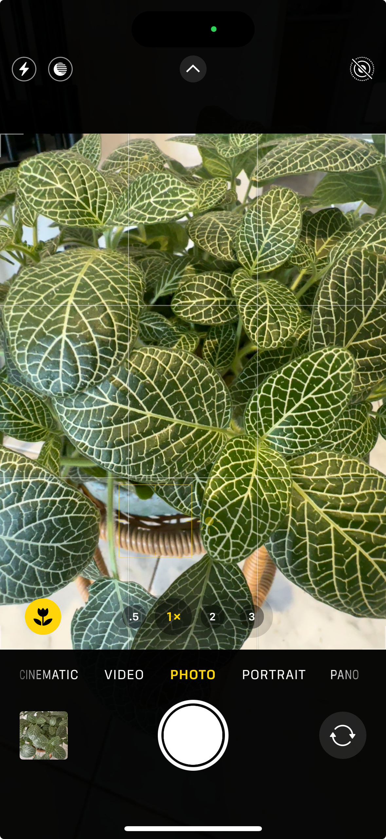
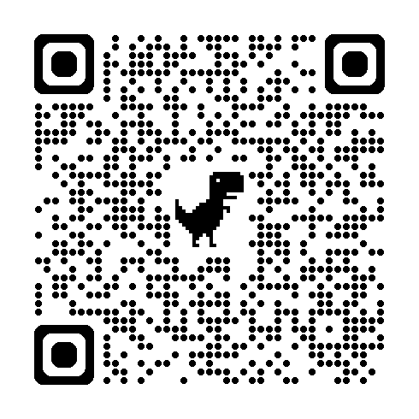
Tech Savvy Seniors
Module 7: Take, save and share great photos and videos
What is the camera app?
Most smartphones and tablets have built-in cameras that let you take photos and videos.
The camera app is usually found on the home screen, and its icon often looks like a small camera.
There’s typically a front and rear camera:
  The rear camera is ideal for taking pictures of people, pets, scenery or events.
  The front camera is good for selfies or video calls.
Take great photos and videos
Consider:
Portrait orientation = phone held upright (good for people or vertical objects).
Landscape orientation = phone held sideways (good for scenery or group shots).
Framing: The subject should be in the middle or slightly off-centre for a more natural look
Lighting: More light usually means a clearer photo. Try to face toward the light.
Focus: Tap the subject on the screen to help the camera focus.
Stability: Holding the phone with two hands or resting elbows on a surface helps reduce blur.
Viewing, deleting and organising your photos
Open the ‘Photos’ (iPhone) or ‘Gallery/Library’ (Android) app to view your photos and videos.
Organise your photos and videos into albums:
  Apple: Tap ‘Albums’ at the bottom > Tap ‘+’ to create a new album > Name it > Select photos to add.
  Android: Open ‘Library’ tab > Tap ‘New album’ or ‘Folder’ > Choose and name it > Select items to include.
Delete unwanted photos and videos to clear up storage: Tap the photo > Tap the bin/trash icon > Confirm the deletion.
Share photos and videos
Open a photo > Tap the Share icon (square with arrow) > Tap the app (e.g. messages, email, Facebook) > Compose the message > Send.
User guide
Scan the QR codes (with your camera) or click the links.
iPhone camera
basics
Use the Table of Contents and explore the Camera section.
How To Take
Good Photos
With Your
Phone
  Flash: Tap to turn on/off
  Mode: Tap to change modes
  Preview thumbnail: Tap to view your last photo/video
  Shutter button: Tap to take a photo/video (depending on mode)
  Flip camera: Switch between front and rear camera
  Zoom: Tap to zoom in/out
1
6
2
3
5
4

