Slide 1
Stay safe online and avoid scams
Tech Savvy Seniors
Module 6

Slide 2

Acknowledgement of Country
We recognise and acknowledge the existing, original, and ancient connection Aboriginal and Torres Strait Islander peoples have to the lands, waterways, and sky country across the Australian continent. We pay our respects to their Elders past and present.
Artwork: 'Connection' by Bobbi Lockyer.

Slide 3





Learning outcomes
By the end of this session, you’ll be able to:
Describe common types of online and phone scams.
Identify scam red flags in email, SMS, phone calls and websites.
Take steps to protect personal information.
Block, delete, or report a suspected scam.
Understand where to go for help and support.

Slide 4

Have you ever received a suspicious message, email, or phone call?

Slide 5

What’s one thing you’d like to feel more confident about by the end of today?

Slide 6
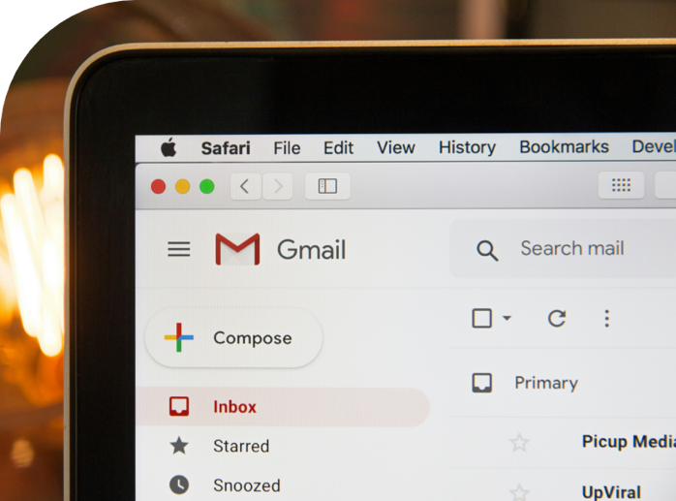
What are scams and why do they matter?
A scam is when someone tries to trick you into giving away your money, personal details, or access to your device.
Scammers pretend to be someone they’re not to get you to trust them.
They’re designed to make you act fast or without thinking.
Learning how they work can help you stay safe.

Slide 7



Scams can be delivered via…
Email
Text messages
Phone calls (real or robocalls)
Pop-up messages while browsing the internet
Social media or messaging apps

Slide 8
Common scams
Bank verification call scam
“This is Commbank. We’ve noticed a suspicious transaction on your card. Can you confirm your full name, account number, and PIN?”

Slide 9
Common scams
Australia Post SMS scam
“We tried to deliver your parcel. Please click the link to pay a small redelivery fee.”

Slide 10
Common scams
Government impersonation email
“Your MyGov account has been locked. Log in here to verify your identity.”

Slide 11
Common scams
Prize or gift card scam
“Congratulations! You’ve won a $500 Coles gift card. Click the link to claim your prize.”

Slide 12
Common scams
Fake invoice or receipt (email)
“Thanks for your payment of $899 to Norton Antivirus. If this was not you, call this number immediately.”

Slide 13
Common scams
Romance scam
“I feel so close to you. I want to come visit, but I can’t afford the ticket. Can you help me?”

Slide 14

Have you seen or received something like this before? What would make you stop and think before responding?

Slide 15

Red flags
Requests for urgent action or threats (“act now or lose access”)
Unusual or unknown sender address or number
Poor spelling, strange grammar, or generic greetings (“Dear customer”)
Links that don’t match the official website (hover to check!)
Asking for personal info, passwords or banking details
Offers that are “too good to be true” (lottery, refunds, gifts)
Messages that make you feel panicked, rushed, or confused

Slide 16
What might make someone believe this is real?
What’s suspicious about it?

Slide 17
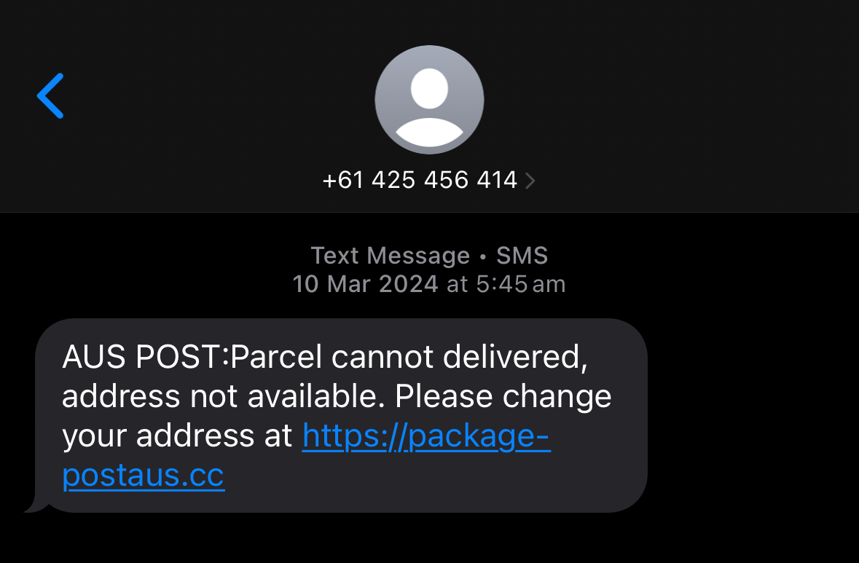
What might make someone believe this is real?
What’s suspicious about it?

Slide 18
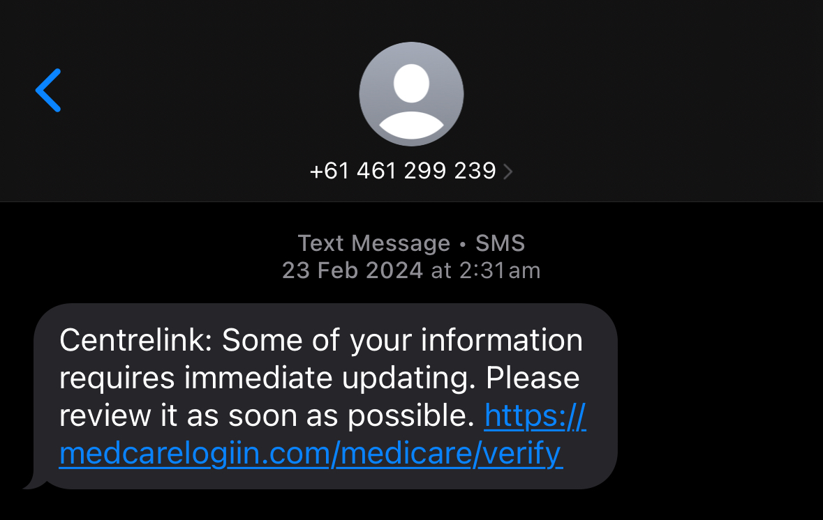
What might make someone believe this is real?
What’s suspicious about it?

Slide 19

So, how might we stay safe?

Slide 20




Source: https://www.scamwatch.gov.au/stop-check-protect

Slide 21
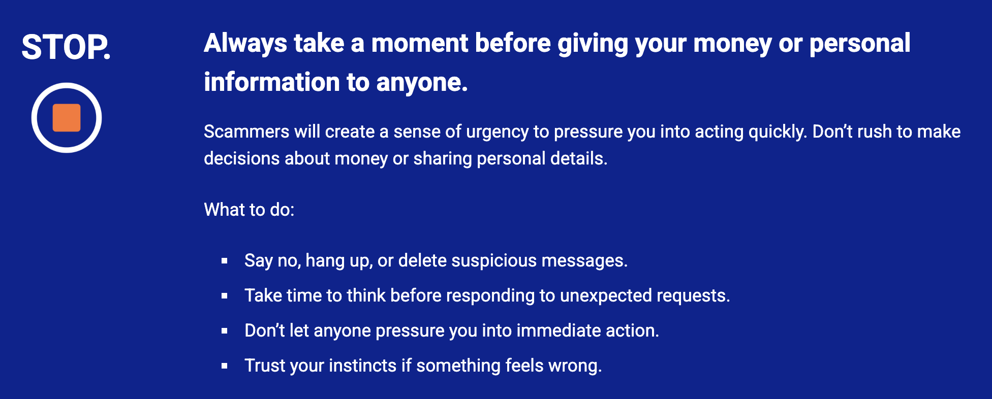

Slide 22
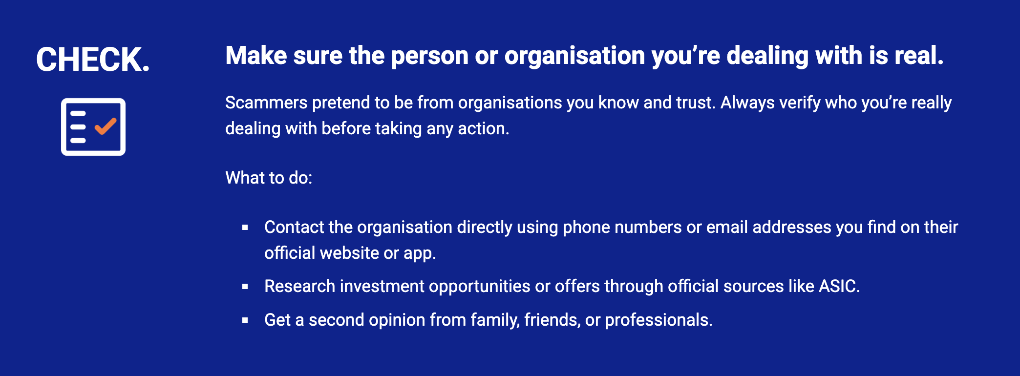

Slide 23
Does your password include…
Lowercase letter
Uppercase letter
Number
Symbol
8+ characters

Slide 24


Device safety
Lock your device
Update your software

Slide 25

Safer online habits
Think before you post: avoid sharing your birthday, home address, phone number, travel plans and your location.
Only shop on trusted websites that begin with https:// and show a padlock icon.
Avoid public Wi-Fi for online banking or logging into important accounts — scammers can steal your details.
Log out of accounts when using shared or public computers (or avoid logging in altogether!).

Slide 26
Safer online habits
Use privacy settings on social media to limit who can see your posts.
Don't accept friend requests or messages from people you don’t know.
Be cautious of pop-up ads, competitions, or prize messages — they’re often scams.
Check app permissions — some apps collect unnecessary data.
Dispose of devices safely.

Slide 27
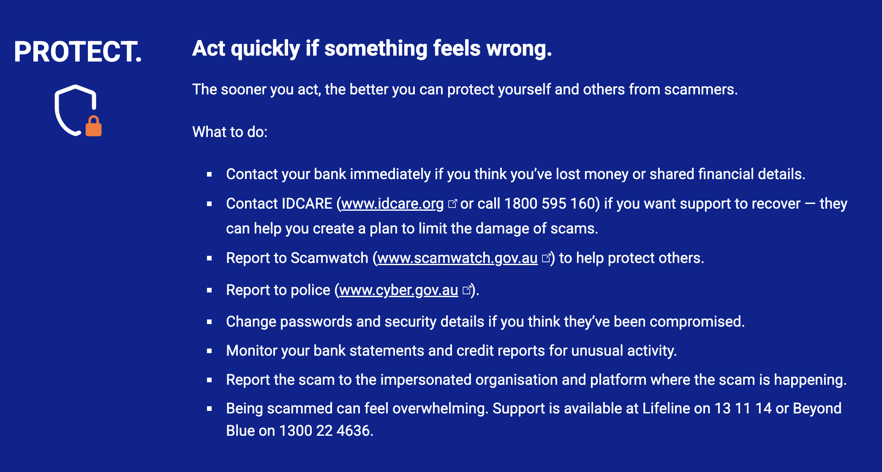

Slide 28
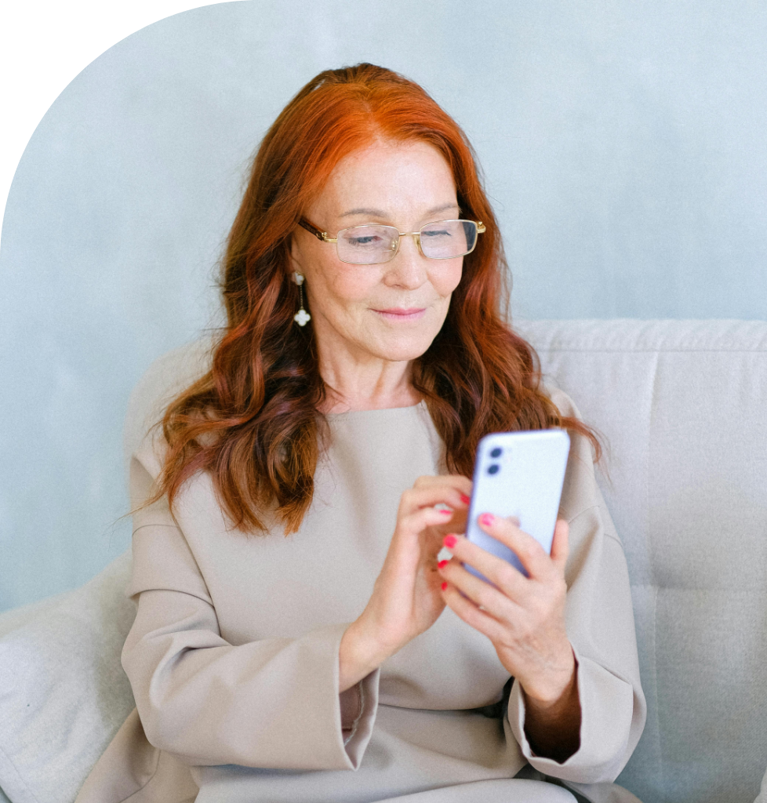
Let’s spend time on your questions from the start of the session.

Slide 29
Learning outcomes
I can:
Describe common types of online and phone scams.
Identify scam red flags in email, SMS, phone calls and websites.
Take steps to protect personal information.
Block, delete, or report a suspected scam.
Understand where to go for help and support.

Slide 30

What’s your key takeaway?

Slide 31

What three things will you try in the next week?

Slide 32
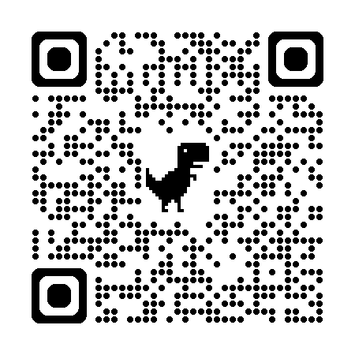
Learn more
BeConnected
Identifying and avoiding scams

Slide 33
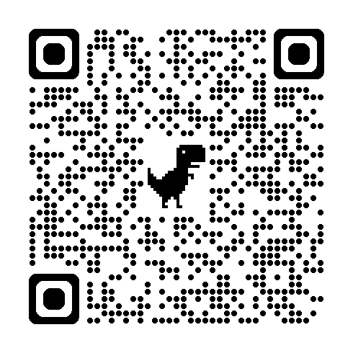
Learn more
NSW Gov
Tips to staying safe online

Slide 34
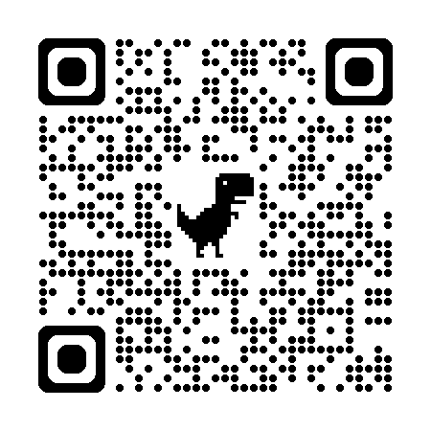
Learn more
Scamwatch

Slide 35
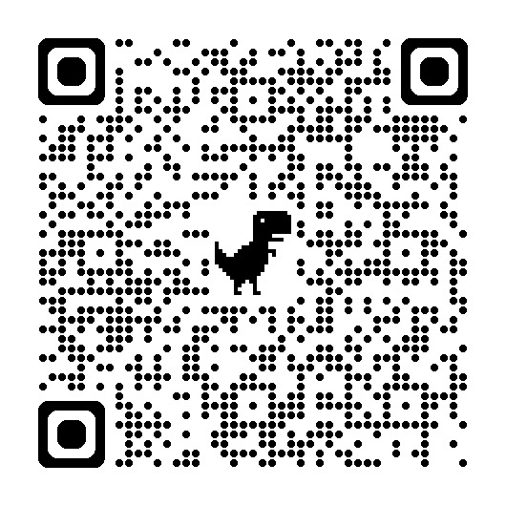
Learn more
Cyber.gov.au
How to dispose of your device securely

Slide 36
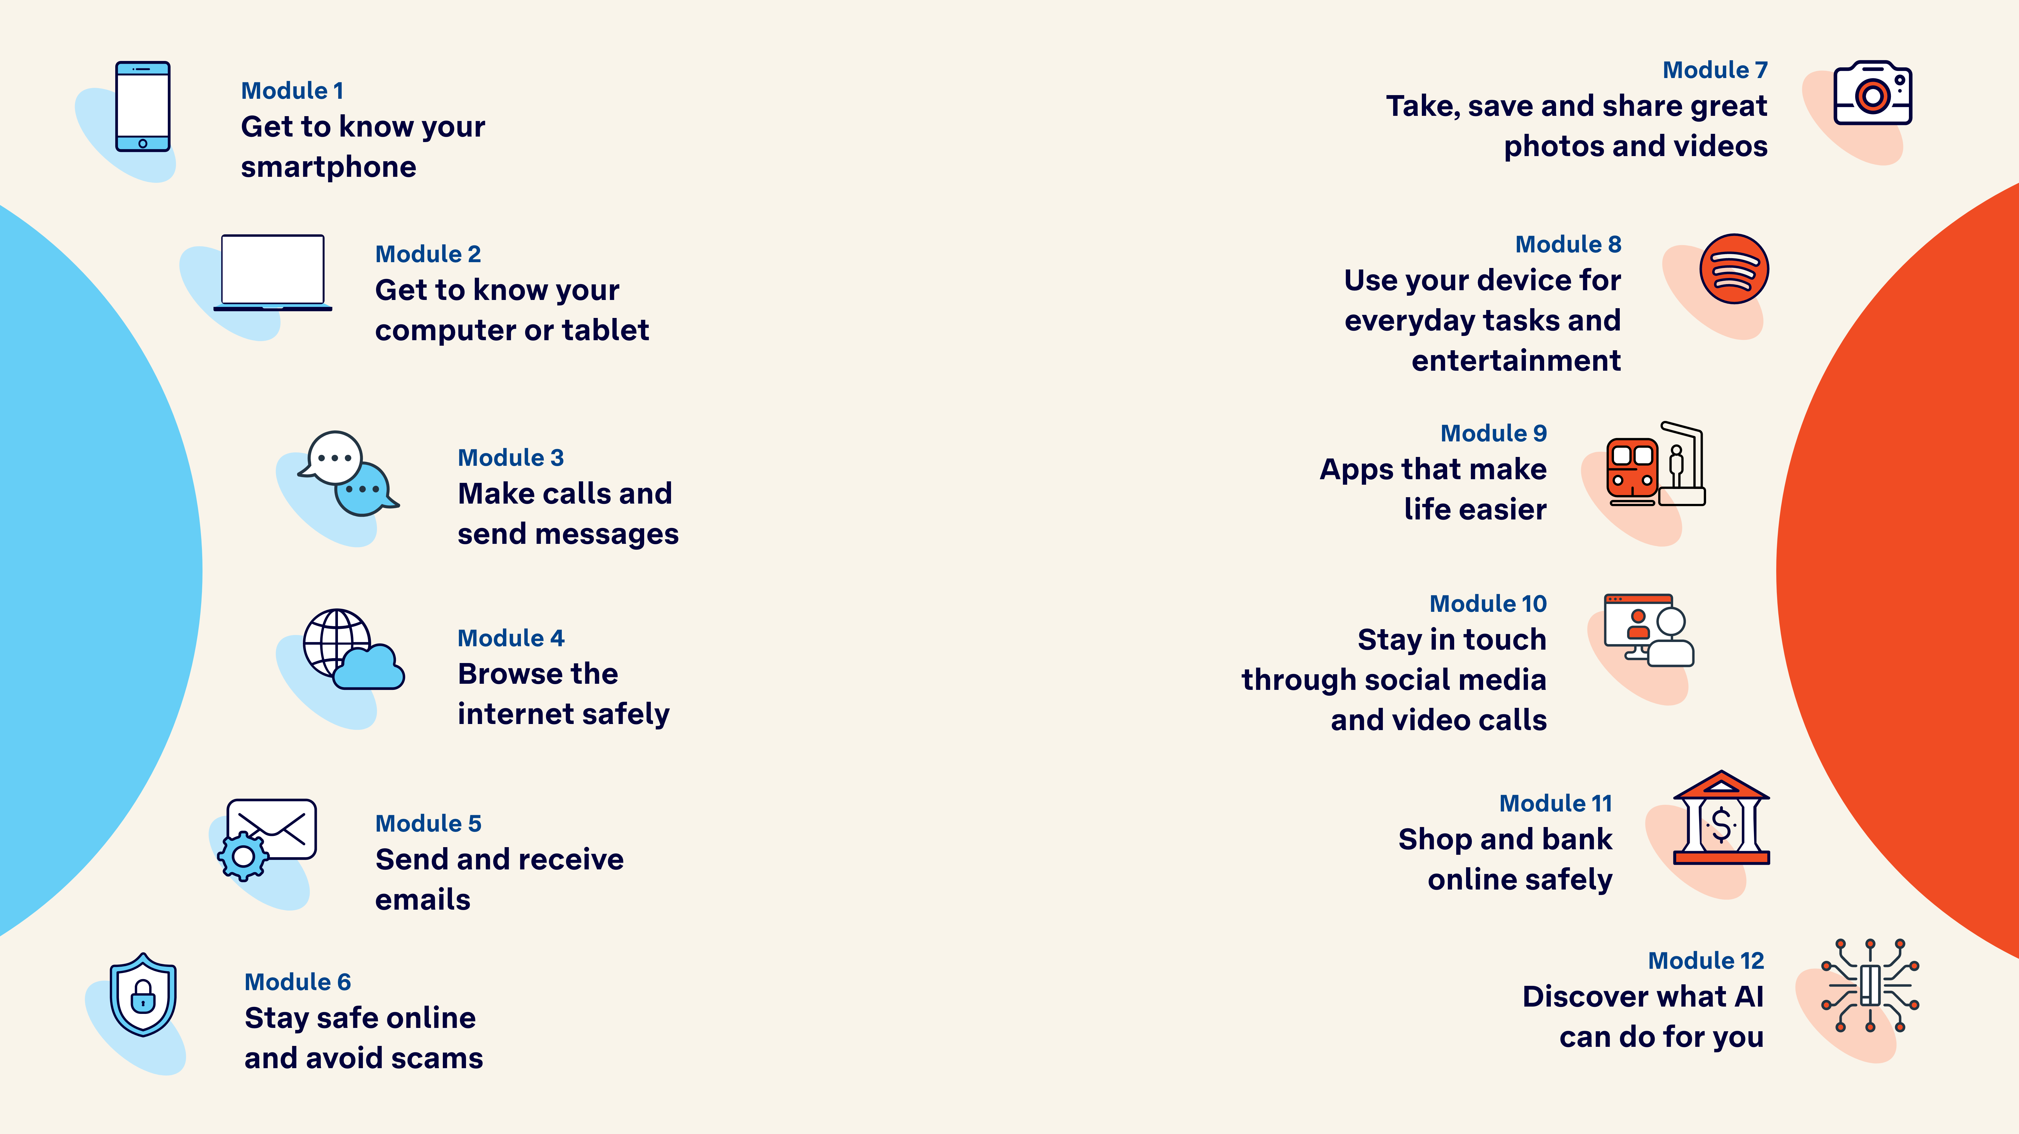
Tech Savvy
Seniors

