Slide 1
Send and receive emails
Tech Savvy Seniors
Module 5

Slide 2

Acknowledgement of Country
We recognise and acknowledge the existing, original, and ancient connection Aboriginal and Torres Strait Islander peoples have to the lands, waterways, and sky country across the Australian continent. We pay our respects to their Elders past and present.
Artwork: 'Connection' by Bobbi Lockyer.

Slide 3




Learning outcomes
By the end of this session, you’ll be able to:
Log into your email account.
Send, reply to, forward and delete emails.
Attach a file or image to an email.
Recognise and report spam or suspicious messages.

Slide 4

Who has an email account?

Slide 5

What’s one thing you’d like to feel more confident about by the end of today?

Slide 6
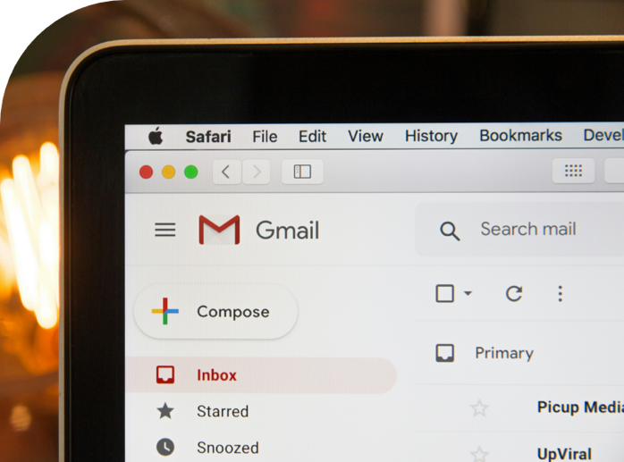
What is email?
Email stands for electronic mail
Use email to communicate with family, friends and businesses
Email is very quick
Read emails on a computer, tablet or smartphone

Slide 7
What is an email address?
sue.smith@gmail.com
Username
‘at’
Email provider

Slide 8



Email providers
Gmail
Outlook
Yahoo!

Slide 9


Connecting to the internet
Wi-Fi
Mobile data

Slide 10
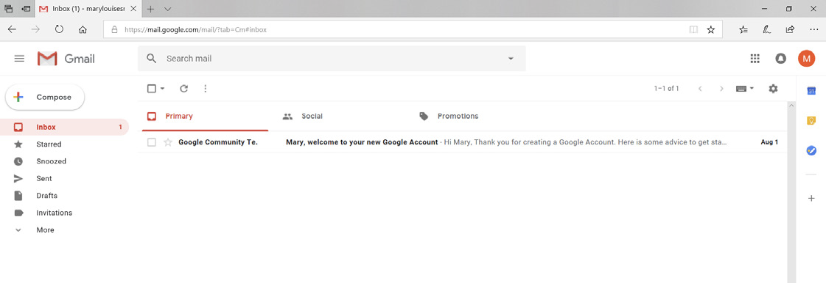
Reading an email

Slide 11
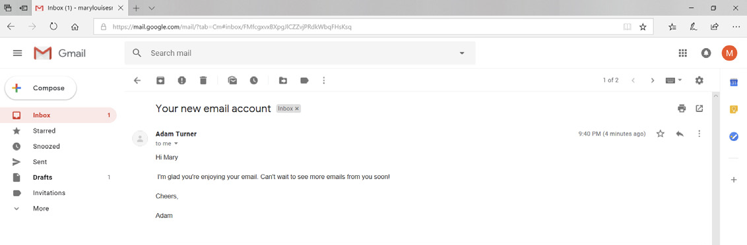
Reading an email

Slide 12

Can you spot any unread messages in your inbox?
Who is the message from?
Was it sent to only you or to others as well?
What clues does the subject line give you about the message?

Slide 13

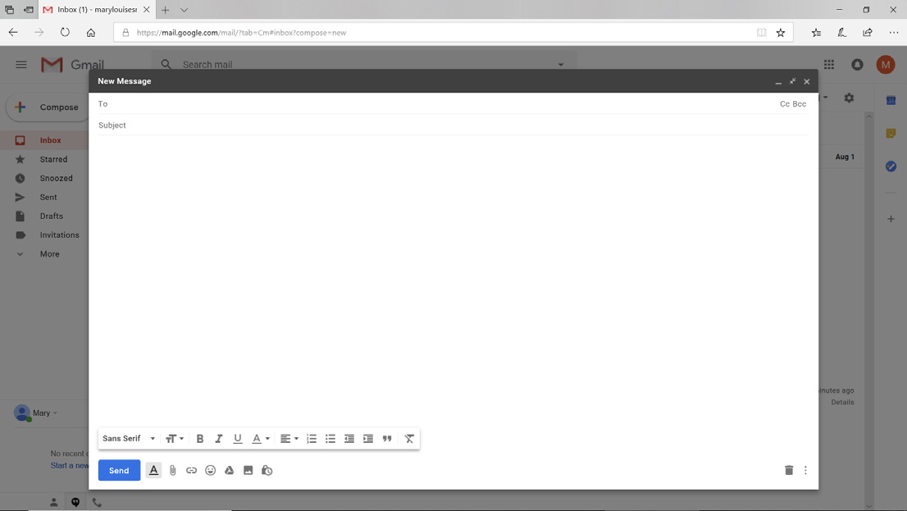
Sending an email

Slide 14

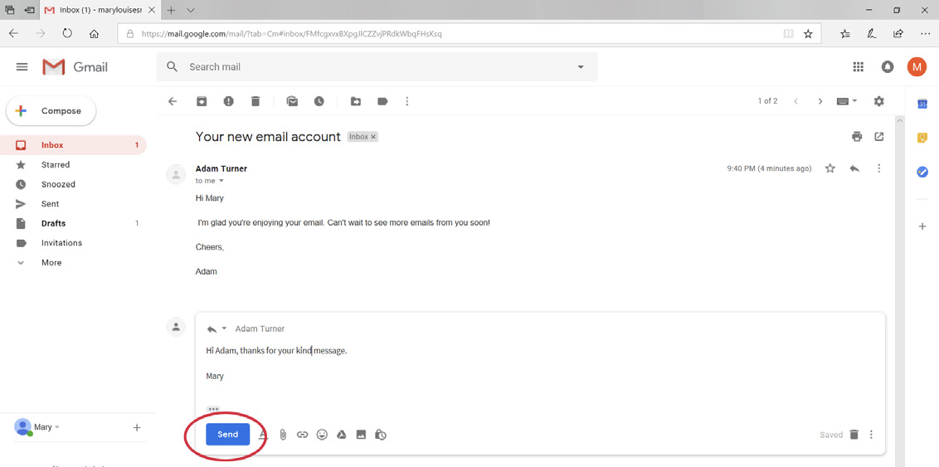
Replying to an email

Slide 15

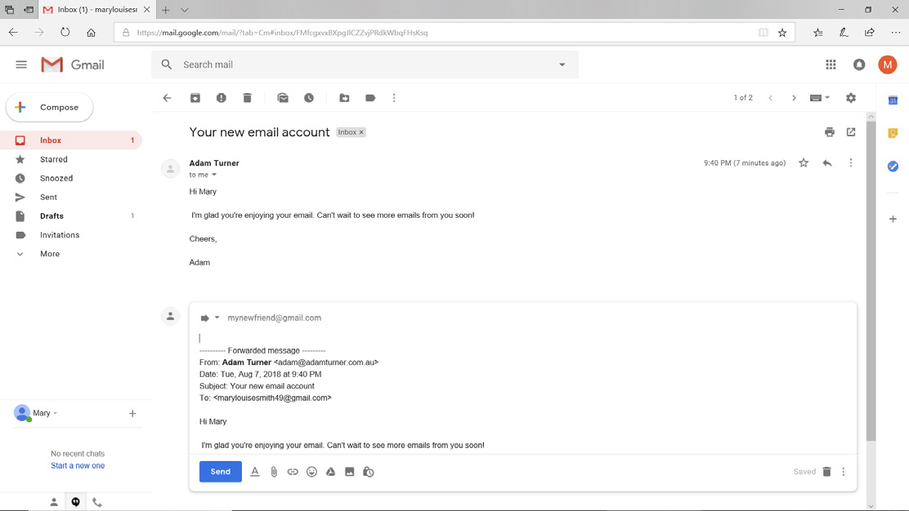
Forwarding an email

Slide 16

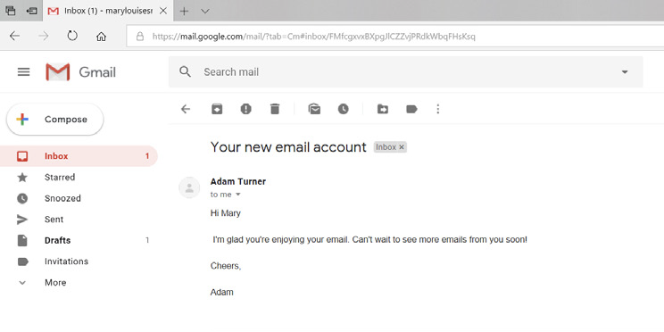
Deleting an email

Slide 17
Key terms…
Spam
Scam/ phishing
Junk folder
Unwanted emails, often advertising or junk.
Emails pretending to be from a trusted source, trying to steal your personal information or money.
Where your email automatically moves suspicious or unwanted messages.

Slide 18
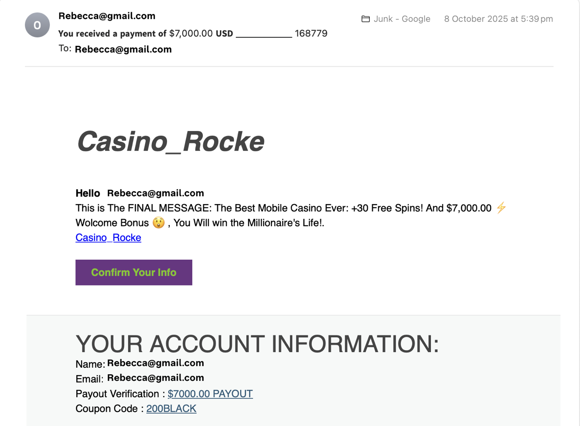
What makes this email suspicious?

Slide 19

Tips
If something feels wrong or too good to be true — like a prize, refund, or threat — it probably is.
Do not click any links or download attachments from emails you don’t trust.
Check the sender’s email address — it should match the company’s official address.
If you’re not sure, you can contact the company directly using their official phone number or website.
A real company (like your bank or Telstra) will never ask for your password by email.

Slide 20

Let’s spend time on your questions from the start of the session.

Slide 21
Learning outcomes
I can:
Log into my email account.
Send, reply to, forward and delete emails.
Attach a file or image to an email.
Recognise and report spam or suspicious messages.

Slide 22

What’s your key takeaway?

Slide 23

What three things will you try in the next week?

Slide 24
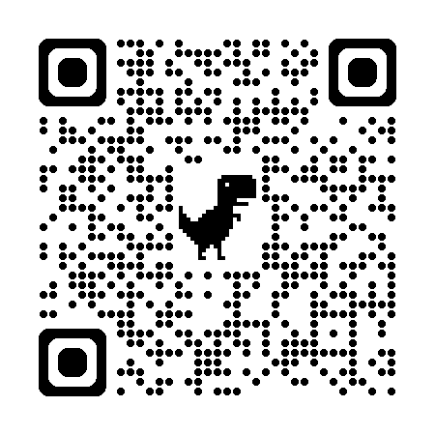
Learn more
Gmail for
beginners

Slide 25
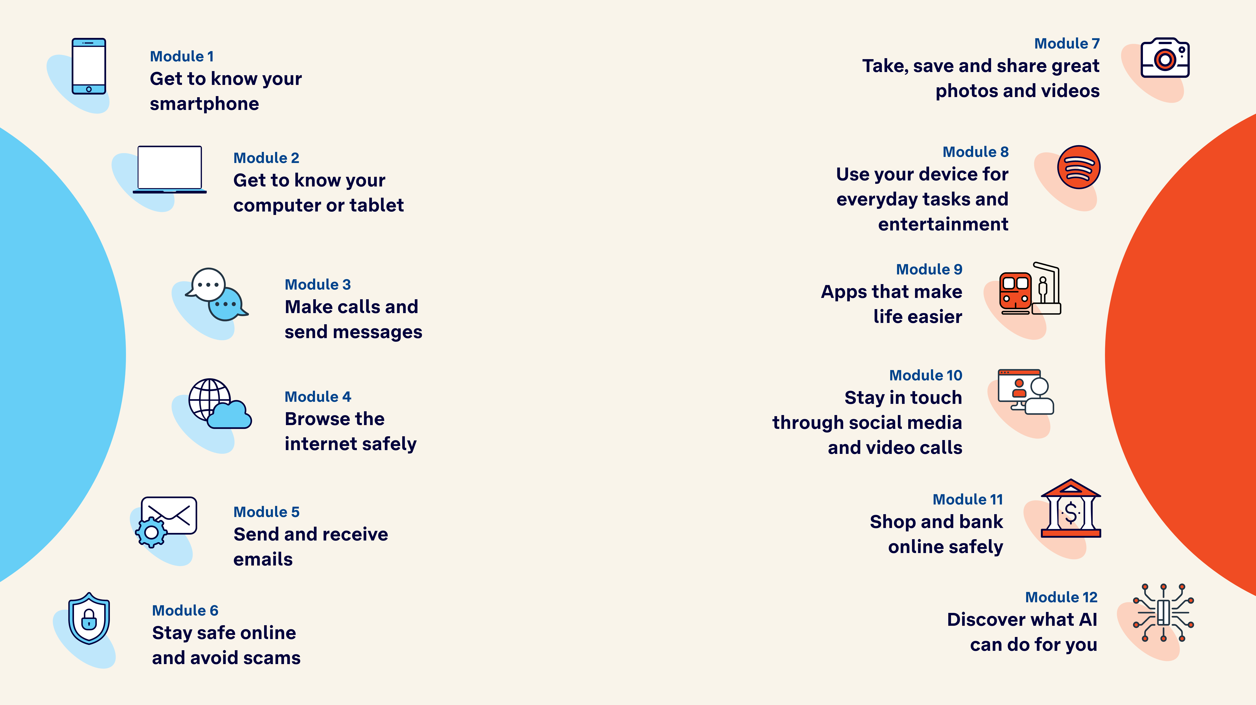
Tech Savvy
Seniors

