Slide 1







Tech Savvy Seniors Module 5: Send and receive emails
My notes
I can:
Log into my email account.
Send, reply to, forward and delete emails.
Attach a file or image to an email.
Recognise and report spam or suspicious messages.
Key takeaways
My key insights from today are:
Support
I can get support from:
My action plan
In the next week, I will:
1
2
3

Slide 2










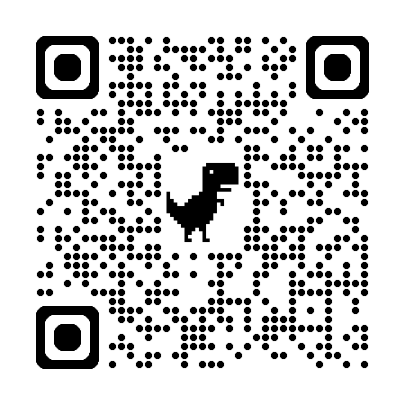
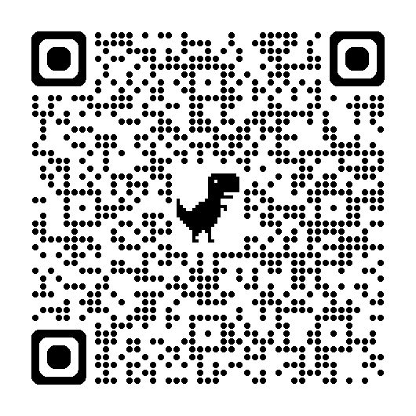
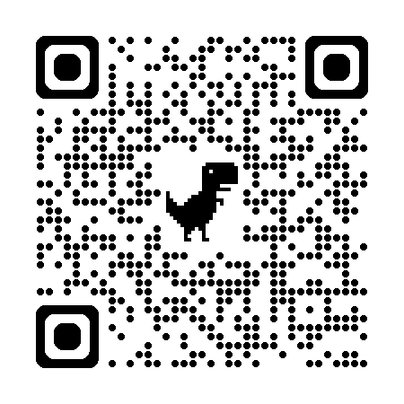
Tech Savvy Seniors Module 5: Send and receive emails
What is an email?
Email (short for electronic mail) is a way to send and receive written messages, photos, files, and links using the internet.
You can use email to:
Stay in touch with family and friends
Receive bills or appointment reminders
Sign up for newsletters or accounts
Contact businesses or organisations
To use email, you'll need:
An email address
Access to a device (computer, tablet, or smartphone)
An internet connection
Create an email address
Create a free email address and Gmail account:
Go to www.gmail.com
Select ‘Create an account’
Follow the prompts
Log into your email account
If you already have an email address, log into your account using a browser or an app.
Open your email provider’s website or app and enter your email address and password.
Read, send, forward and delete emails
To send an email:
Select Compose (or + sign)
In “To”, enter the email address (e.g. friend@example.com)
Add a Subject
Type your message
Select the paperclip icon to add an attachment (e.g. photo)
Select Send (paper plane icon)
Unread emails appear bold in your inbox
To read: Select to open and read emails
To reply: Select the reply icon > type your message > select Send
To forward: Select the forward icon > type your message > select Send
To delete: Select the email > select he delete icon
Recognising suspicious emails
If something feels wrong or too good to be true — like a prize, refund, or threat — it probably is.
Do not open any links or download attachments from emails you don’t trust.
If you’re not sure, you can contact the company directly before opening anything suspicious.
A real company (like your bank or Telstra) will never ask for your password by email.
Key icons
New email
Send
Reply
Reply all
Forward
Delete
Attachment
User guide
Scan the QR code (with your camera) or select the link.
Gmail for beginners
eSafety
What happens to your digital accounts after you die
Service NSW
Get started making a will

