Slide 1
Browse the internet safely
Tech Savvy Seniors
Module 4

Slide 2

Acknowledgement of Country
We recognise and acknowledge the existing, original, and ancient connection Aboriginal and Torres Strait Islander peoples have to the lands, waterways, and sky country across the Australian continent. We pay our respects to their Elders past and present.
Artwork: 'Connection' by Bobbi Lockyer.

Slide 3





Learning outcomes
By the end of this session, you’ll be able to:
Explain what the internet is and how it can be used.
Use a web browser to search for everyday information.
Recognise safe, trustworthy websites and warning signs of risky ones.
Navigate between websites using tabs.
Return to a favourite website using a bookmark or history.

Slide 4
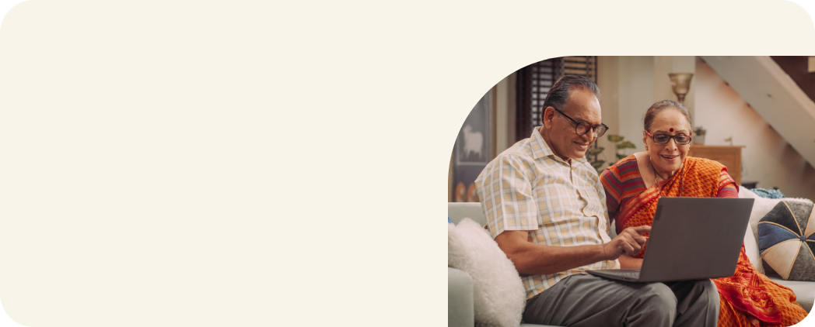
Who has used an internet browser to search for something?

Slide 5
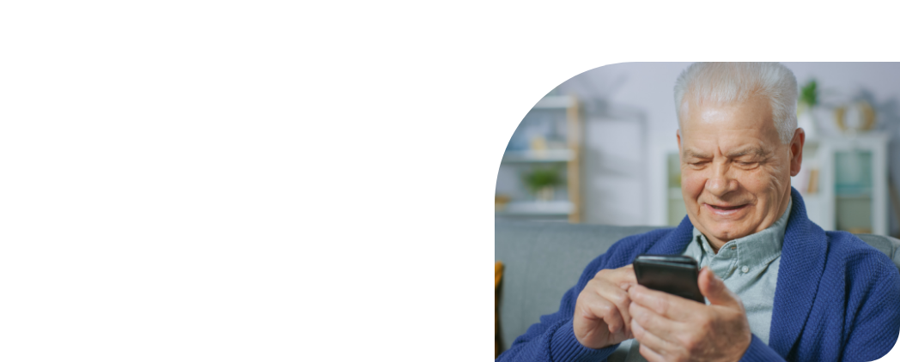
What’s one thing you’d like to feel more confident about by the end of today?

Slide 6
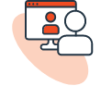




What can you do on the internet?
Stay in touch
Find information
Video call
Search for recipes, health advice, or news
Email
Check the weather
Look up maps and directions
Social media

Slide 7





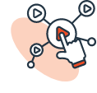


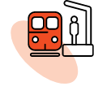
What can you do on the internet?
Practical tasks
Entertainment
Shop
Listen to music, podcasts and audiobooks
Save dates in the calendar
Play games
Banking
Watch videos
Write letters
Read e-books
Book tickets and appointments
And so much more!

Slide 8
Key terms…
Internet
Wi-Fi
Data
The system that connects computers, phones and information around the world.
A way to connect to the internet wirelessly, often available at home and in public places like libraries and cafes.
What lets your phone use internet when you're not on Wi-Fi.

Slide 9
Key terms…
Website
Browser
Search engine
A place on the internet (like an online newspaper, library, or shop).
An app that lets you visit websites (e.g. Chrome, Edge).
A tool that helps you find websites or information (e.g. Google).

Slide 10


Connecting to the internet
Wi-Fi
Mobile data

Slide 11


Connecting to Wi-Fi
Apple
Select settings
Select Wi-Fi
Choose a network
Enter the password
Android and Windows
Select settings
Select Network & Internet or Connections
Choose a network
Enter the password

Slide 12




Browsers
Chrome
Safari
Edge
Firefox

Slide 13
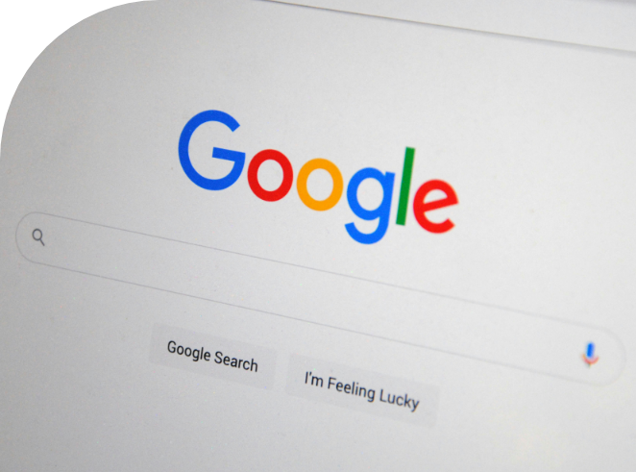
Let’s search the internet!

Slide 14

What did you search for?

Slide 15

Safe vs unsafe websites
A safe website usually:
Has a padlock icon in the address bar
Has an address that starts with “https://” (the ‘s’ stands for ‘secure’)
Is easy to read and doesn’t have lots of pop-ups or spelling mistakes
Ends in something familiar, like .com.au, .gov.au, or .org

Slide 16

Safe vs unsafe websites
An unsafe or suspicious website might:
Have pop-up messages or flashing warnings
Ask for personal or bank details straight away
Contain poor grammar or strange-looking words
Use an unusual web address
The browser might give a warning message before you visit a dangerous site or download a harmful app

Slide 17

Has anyone received scam emails, text messages or phone calls? How did you know it was a scam?

Slide 18
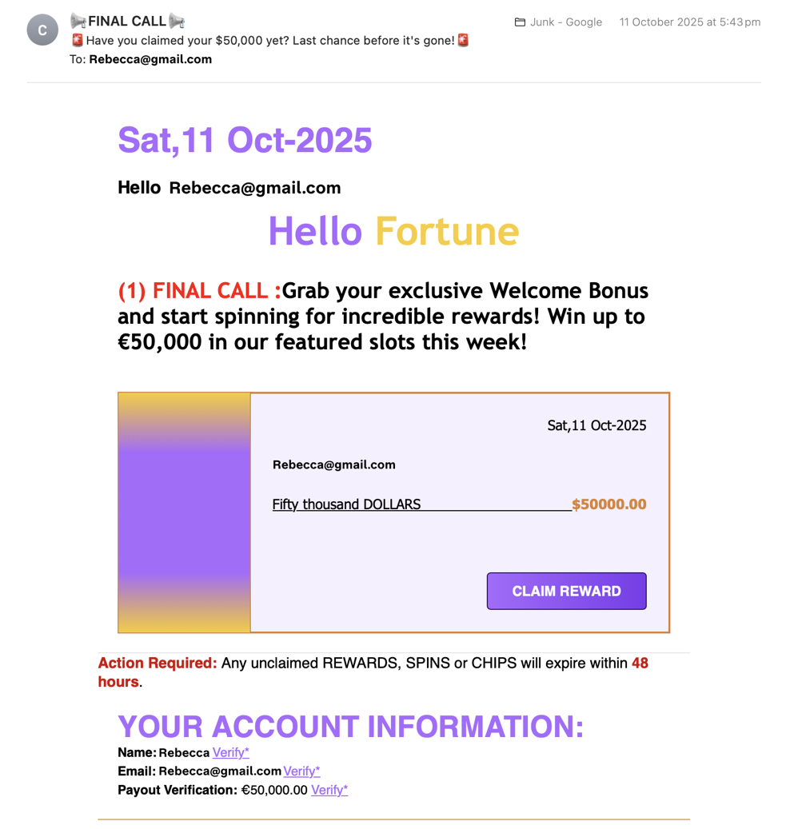
What makes this email suspicious?

Slide 19
Unusual sender name
‘Final Call’
Requests urgent action and
sounds too good to be true
Poor grammar and suspicious currency
Unusual links

Slide 20
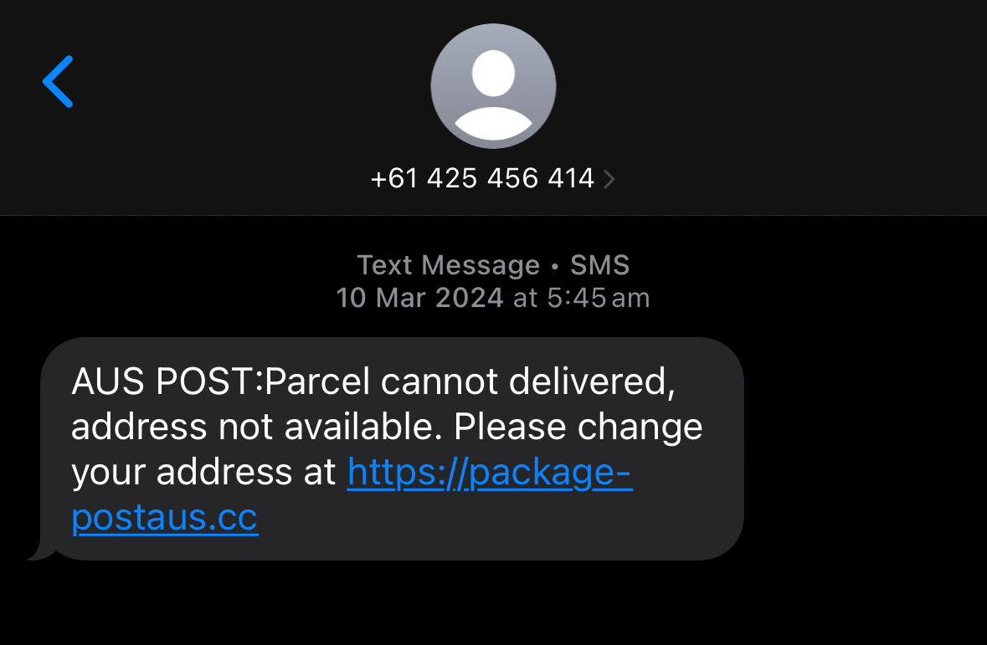
What makes this SMS suspicious?

Slide 21
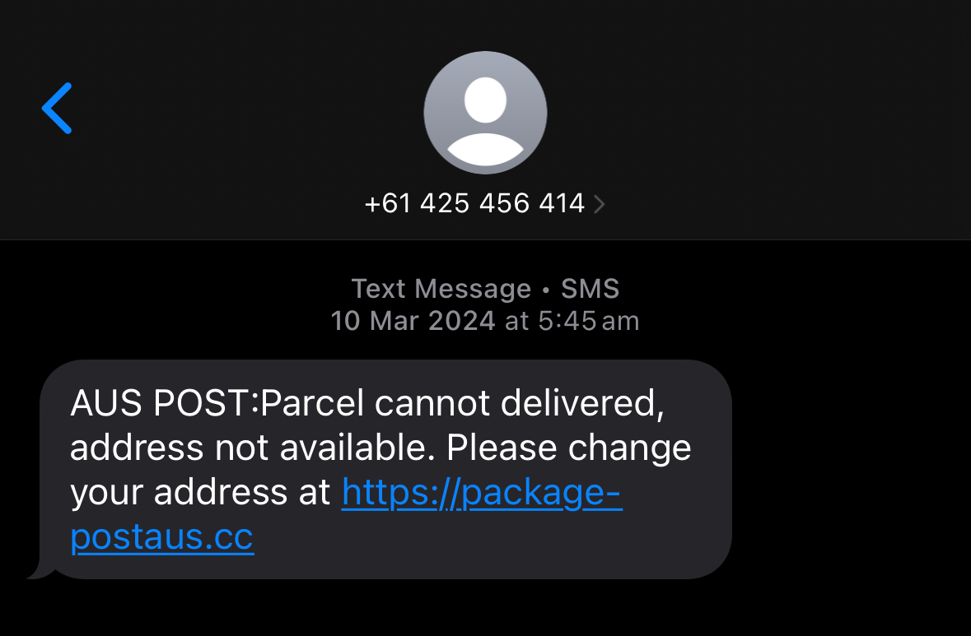
From an unknown mobile number
Spelling and grammatical errors
(e.g. missing space after colon)
Asking for personal details (address)
Suspicious link
Australia Post’s website is https://auspost.com.au/

Slide 22




Source: https://www.scamwatch.gov.au/stop-check-protect

Slide 23
Tips
Only enter personal details on websites you know are safe – with a padlock and https:// at the beginning of the URL.
If you see spelling errors, flashing warnings, or unusual pop-ups, it’s best to leave the site.
Government and banks will never ask for information via text or email.
Use strong passwords and change them twice a year.

Slide 24



Use tabs and return to favourite sites
Tabs
Bookmarks
History

Slide 25
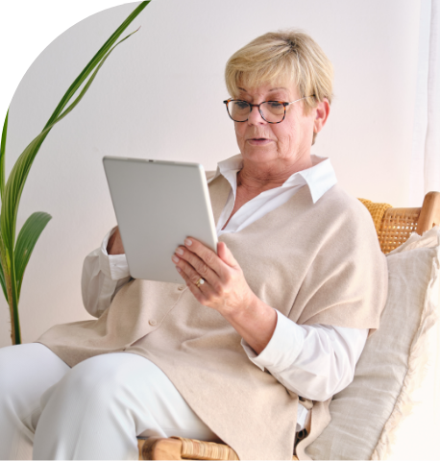
Let’s spend time on your questions from the start of the session.

Slide 26
Learning outcomes
I can:
Explain what the internet is and how it can be used.
Use a web browser to search for everyday information.
Recognise safe, trustworthy websites and warning signs of risky ones.
Navigate between websites using tabs.
Return to a favourite website using a bookmark or history.

Slide 27

What’s your key takeaway?

Slide 28

What three things will you try in the next week?

Slide 29
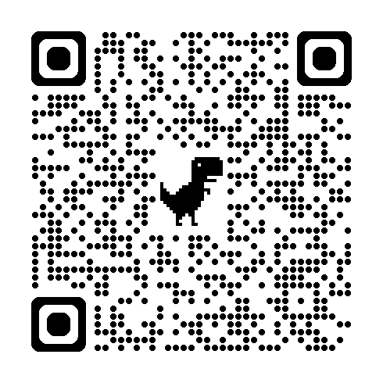
Learn more
Tips to
staying
safe online

Slide 30
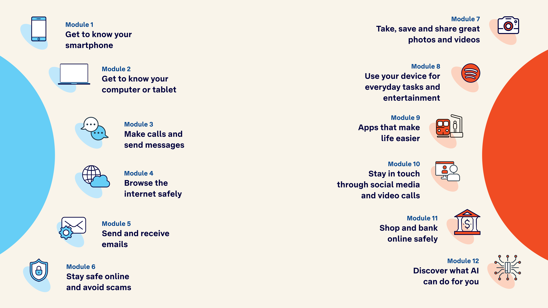
Tech Savvy
Seniors

