Slide 1

Make calls and send messages
Tech Savvy Seniors
Module 3

Slide 2

Acknowledgement of Country
We recognise and acknowledge the existing, original, and ancient connection Aboriginal and Torres Strait Islander peoples have to the lands, waterways, and sky country across the Australian continent. We pay our respects to their Elders past and present.
Artwork: 'Connection' by Bobbi Lockyer.

Slide 3





Learning outcomes
By the end of this session, you’ll be able to:
Make and receive a phone call.
Send and reply to a text message.
Recognise and manage missed calls or message notifications.
Add, edit or delete contacts.
Use messaging apps like WhatsApp or Messenger (optional).

Slide 4
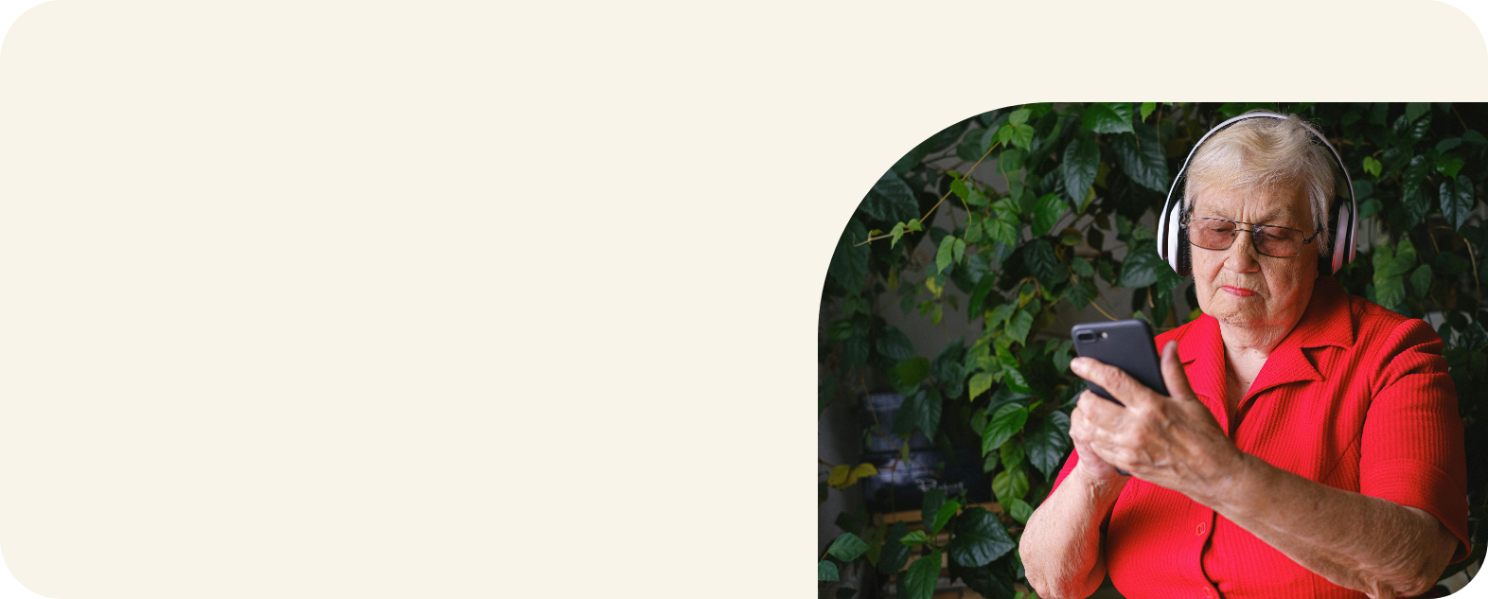
Who has used their device to make a phone call or send a text message?

Slide 5
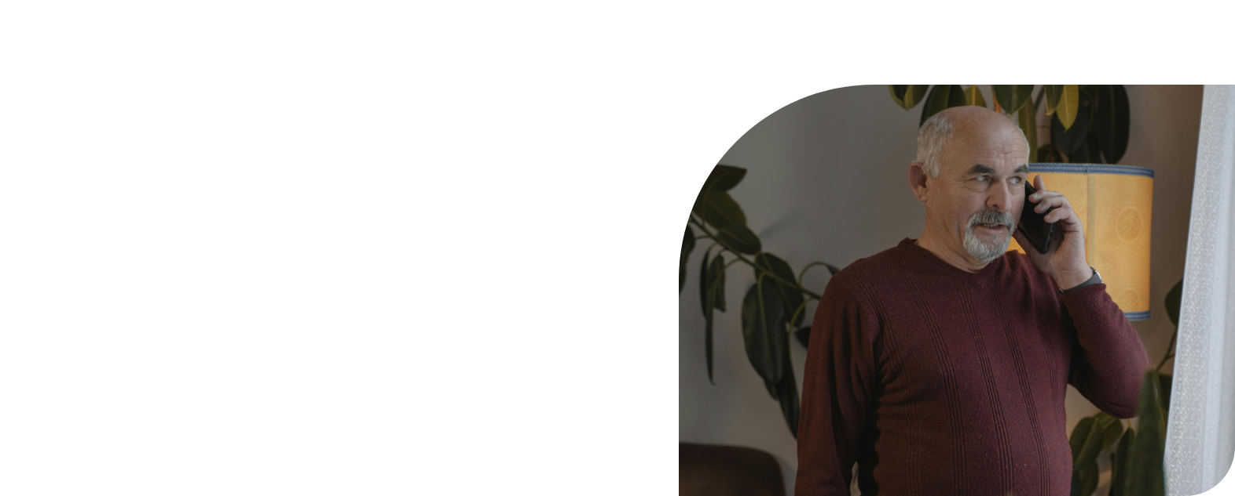
What’s one thing you’d like to feel more confident about by the end of today?

Slide 6



To make a phone call, you need…
To turn on your phone
Mobile signal or a Wi-Fi connection
Phone plan/credit or a Wi-Fi connection

Slide 7






Make calls from…
Phone
Contacts
Messages

Slide 8
To send a text message, you need…
To turn on your phone
Mobile signal or a Wi-Fi connection
Phone plan/credit or a Wi-Fi connection

Slide 9
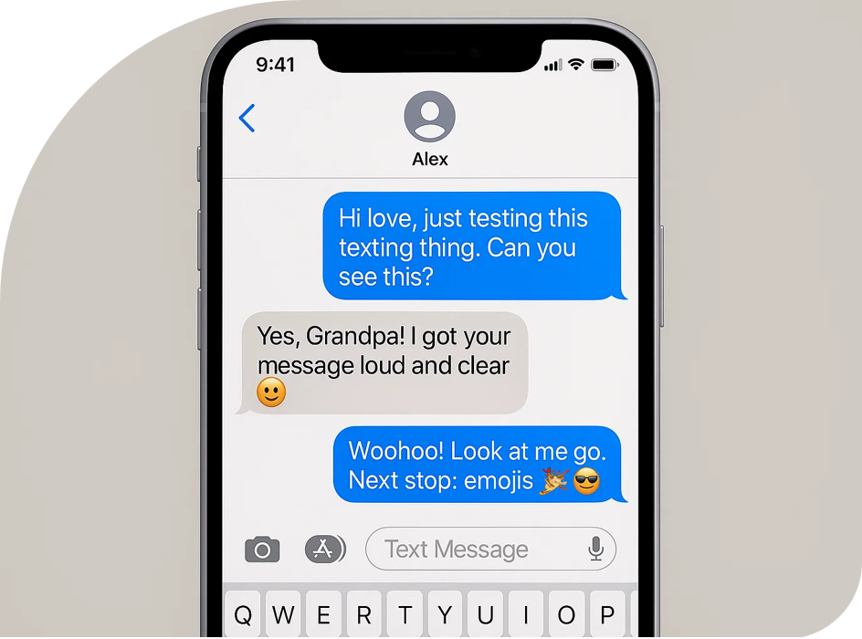
Let’s send and receive text messages

Slide 10
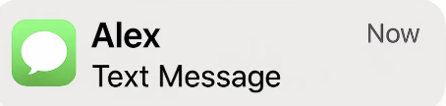
Understanding notifications
1
Banners
Badges
1

Slide 11
Add and manage contacts

Slide 12


Messaging apps
Use Wi-Fi or mobile data
Great for international communication
Create group messages
Download from the app store
Messenger
WhatsApp

Slide 13
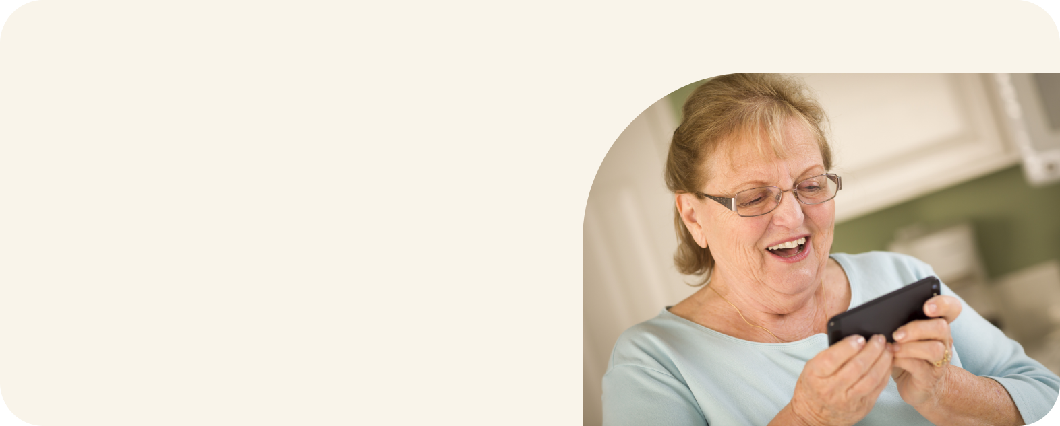
Can you think of a group you’d like to message all at once — like family, friends or a hobby group?

Slide 14
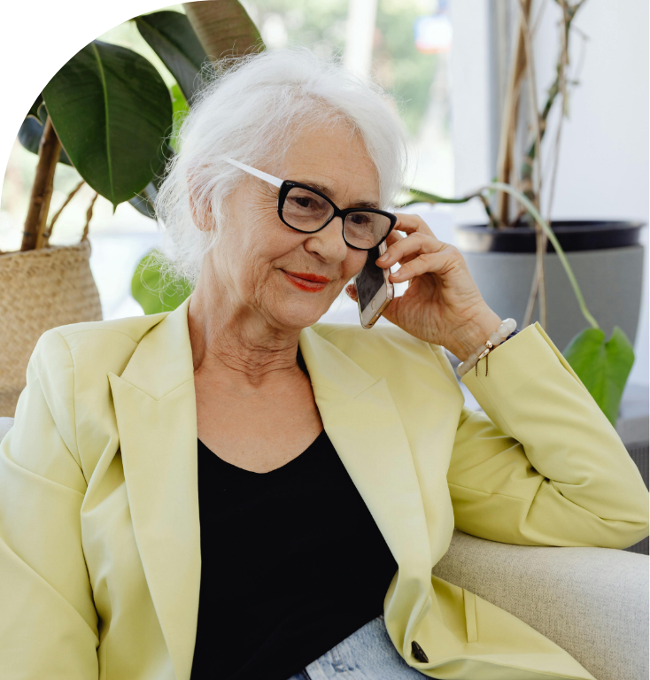
Let’s spend time on your questions from the start of the session.

Slide 15
Learning outcomes
I can:
Make and receive a phone call.
Send and reply to a text message.
Recognise and manage missed calls or message notifications.
Add, edit or delete contacts.
Use messaging apps like WhatsApp or Messenger (optional).

Slide 16

What’s your key takeaway?

Slide 17

What three things will you try in the next week?

Slide 18
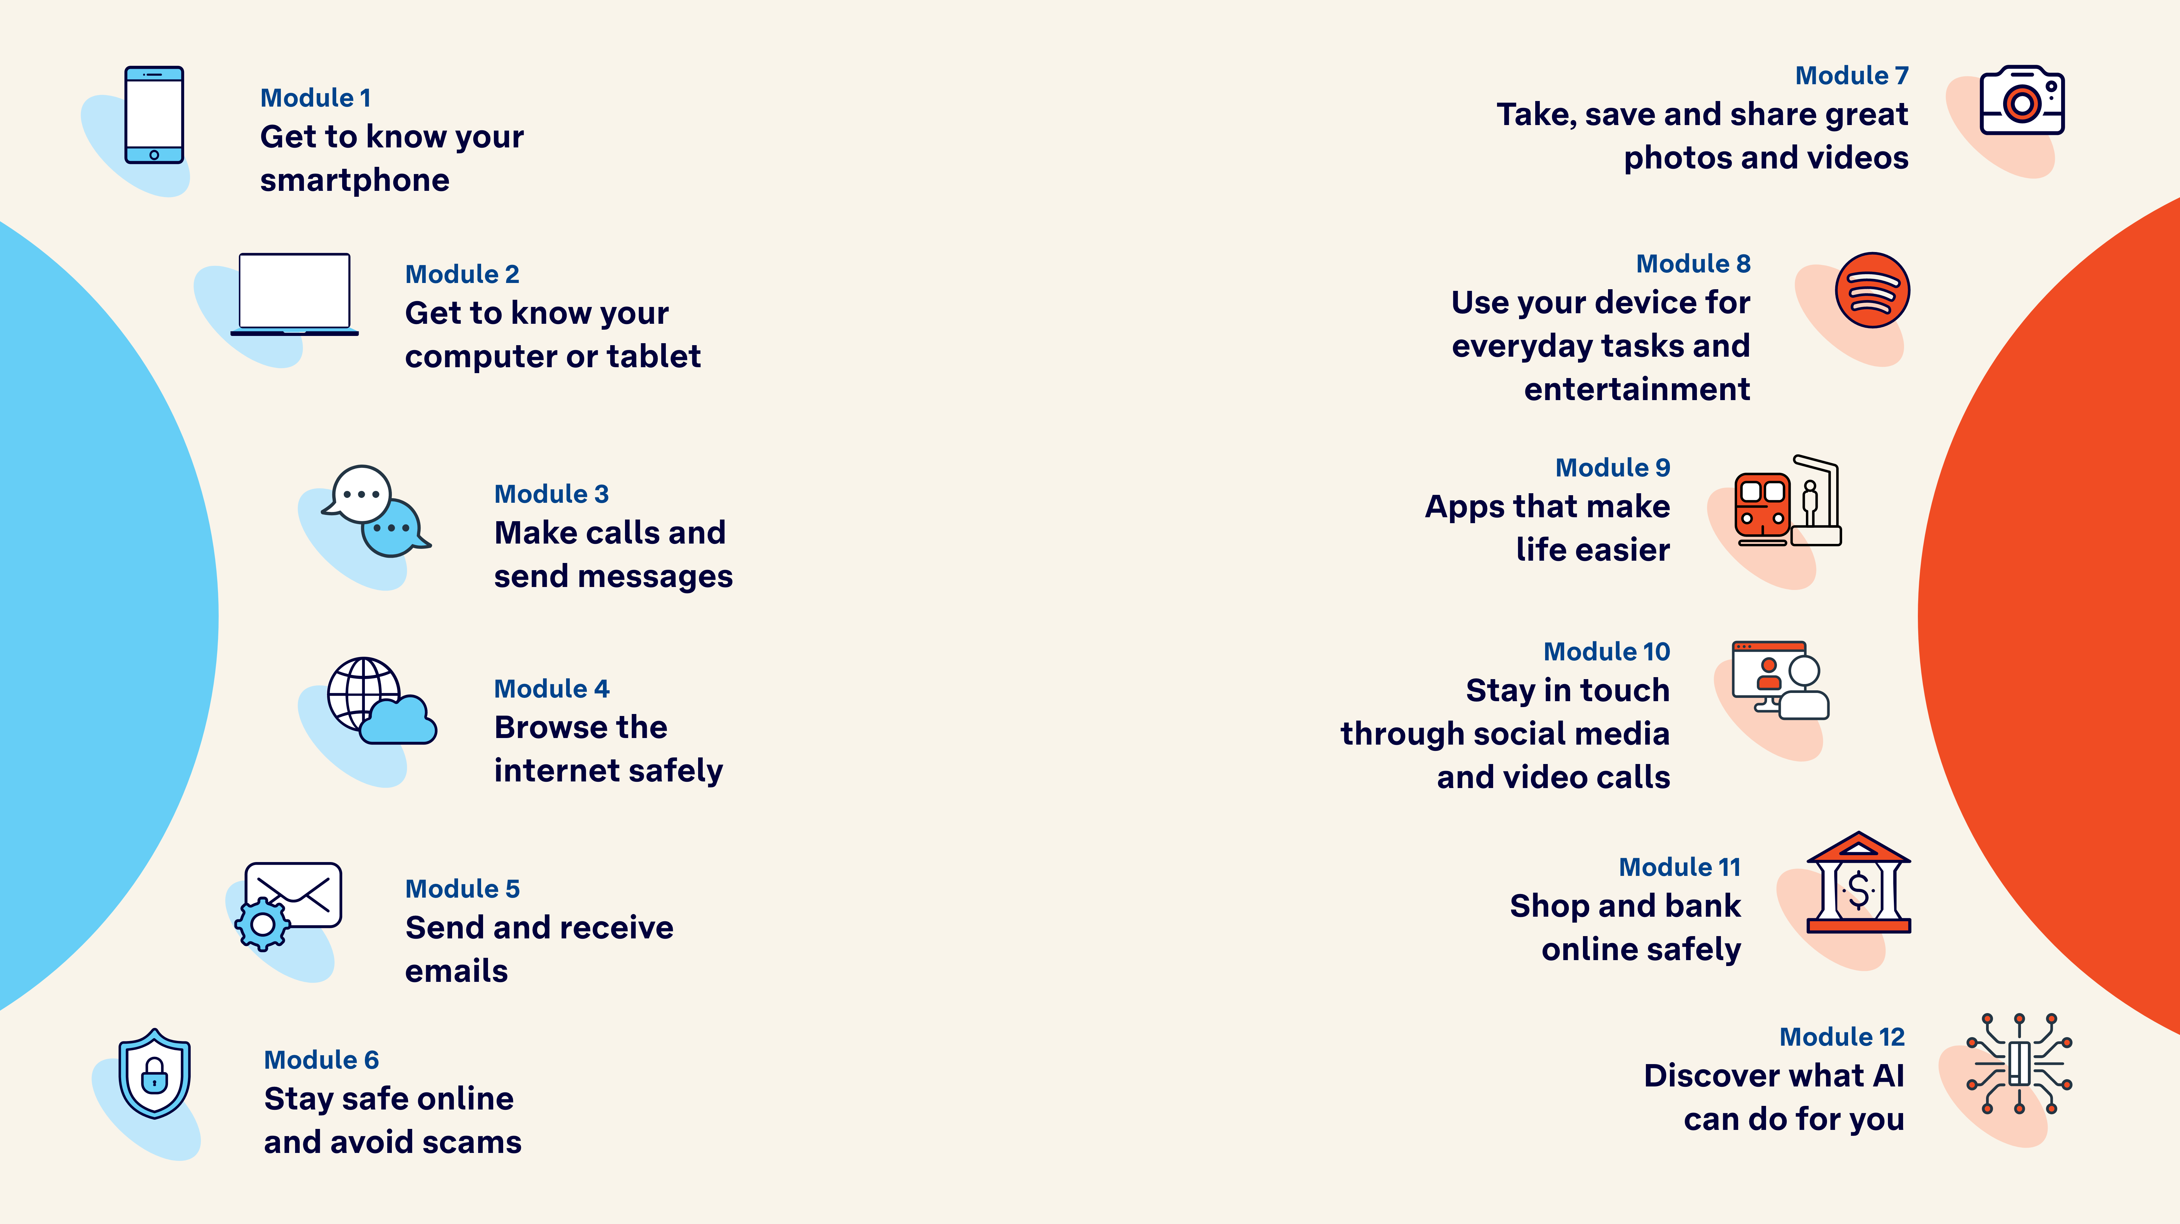
Tech Savvy
Seniors

