Slide 1







Tech Savvy Seniors
Module 3: Make calls and send messages
My notes
I can:
Make and receive a phone call.
Send and reply to a text message.
Recognise and manage missed calls or message notifications.
Add, edit or delete contacts.
Use messaging apps like WhatsApp or Messenger (optional).
Key takeaways
My key insights from today are:
Support
I can get support from:
My action plan
In the next week, I will:
1
2
3

Slide 2


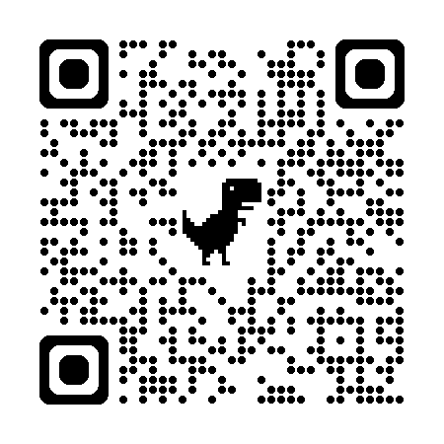

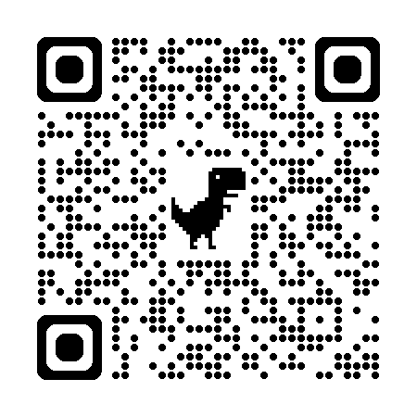
Tech Savvy Seniors
Module 3: Make calls and send messages
Make a phone call
To make a phone call:
  Open the Phone app.
  Tap the keypad to type a number, or choose someone from your Contacts.
  Press the green phone icon to start the call.
  Tap the red button to hang up.
Send a text message
To send a text message:
  Open the Messages app.
  Tap ‘Start chat’ or the + or New Message icons.
  Choose a contact or type in a phone number.
  Write your message using the keyboard.
  Tap Send (paper plane or arrow icon).
  To reply, tap the message and type your response.
Want to make your messages more fun or personal? You can also:
  Send an emoji – Tap the smiley face icon on your keyboard and choose a face or symbol.
  Send a photo or video – Tap the paperclip or camera icon and choose from your gallery or take a new one.
  Send a voice message – Tap the microphone/soundwave icon, speak, and tap Send (available in many apps and newer phones).
Add and manage contacts
Save new phone numbers in your Contacts app.
You can also edit or delete old contacts.
Add favourites for people you call often:
  iPhone: Open the Phone app > tap Favourites > tap + to add someone from your contacts.
  Android: Open the Contacts app > tap a contact > tap the star icon to favourite.
Notifications
Your phone shows alerts when you miss a call or receive a message.
Swipe down from the top of your screen to view and clear notifications.
Look for red dots or message icons as reminders.
Messaging apps
Apps like WhatsApp and Messenger let you message and call using Wi-Fi or mobile data (not phone credit), which make them particularly useful in contacting people internationally.
These are free to download from the App Store (Apple) or Play Store (Android).
iMessage is built into iPhones — it doesn’t need to be downloaded, just turned on in Settings. It only works with other Apple devices.
You can also start group chats to stay in touch with family, friends or clubs.
User guides
Scan the QR codes (with your camera) or select the links.
iPhone
Android

