Slide 1

Get to know your computer or tablet
Tech Savvy Seniors
Module 2

Slide 2

Acknowledgement of Country
We recognise and acknowledge the existing, original, and ancient connection Aboriginal and Torres Strait Islander peoples have to the lands, waterways, and sky country across the Australian continent. We pay our respects to their Elders past and present.
Artwork: 'Connection' by Bobbi Lockyer.

Slide 3



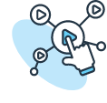
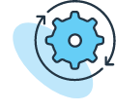
Learning outcomes
By the end of this session, you’ll be able to:
Explain what computers and tablets are and list common things they can do.
Identify key physical features.
Turn your computer or tablet on/off and unlock it.
Navigate using basic gestures (tablet) or mouse/trackpad and keyboard (computer).
Adjust basic settings like brightness, text size and volume.

Slide 4
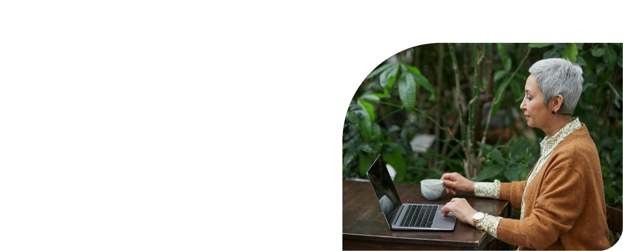
What’s one thing you’d like to feel more confident about by the end of today?

Slide 5
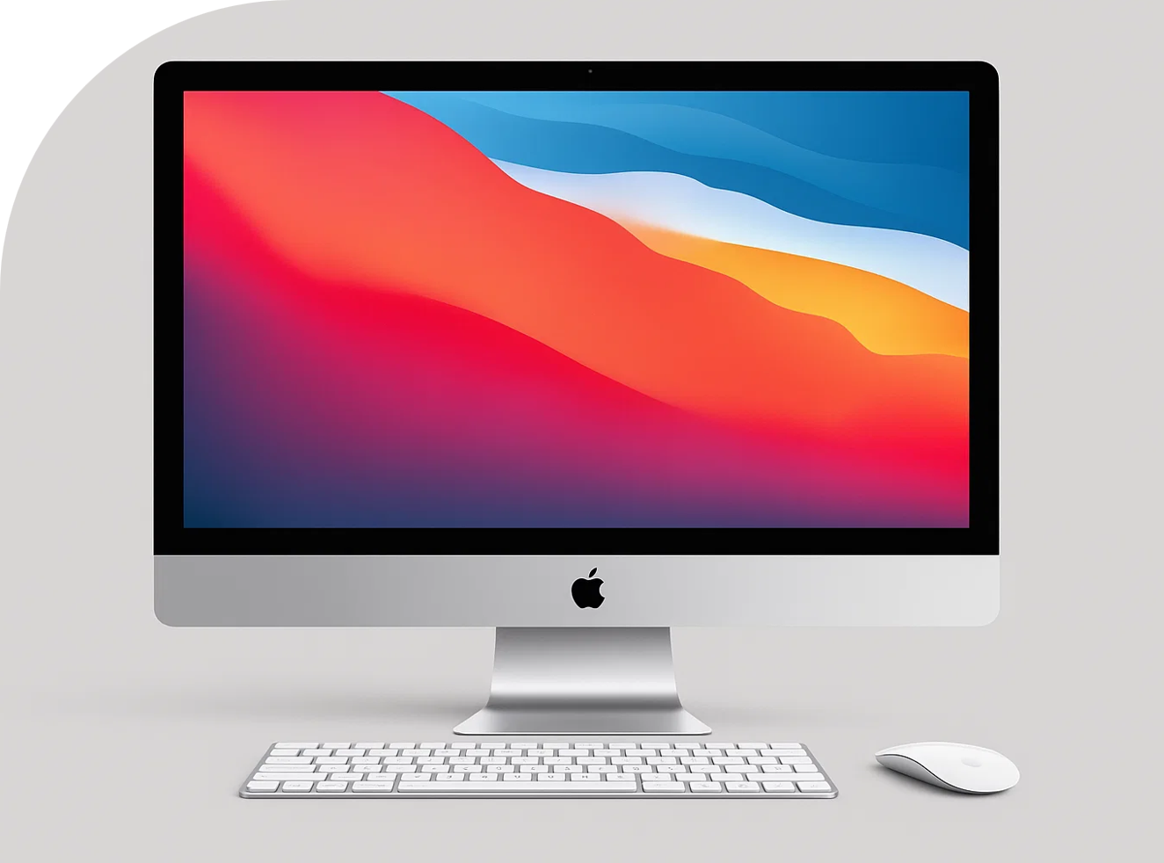
What is a computer?
Desktop computer
Stays in one place
Consists of:
  A monitor
  A keyboard
  A mouse
  A computer box

Slide 6

What is a computer?
Laptop computer
Portable (battery, with charger)
Fold open and shut
Screen, keyboard and trackpad

Slide 7
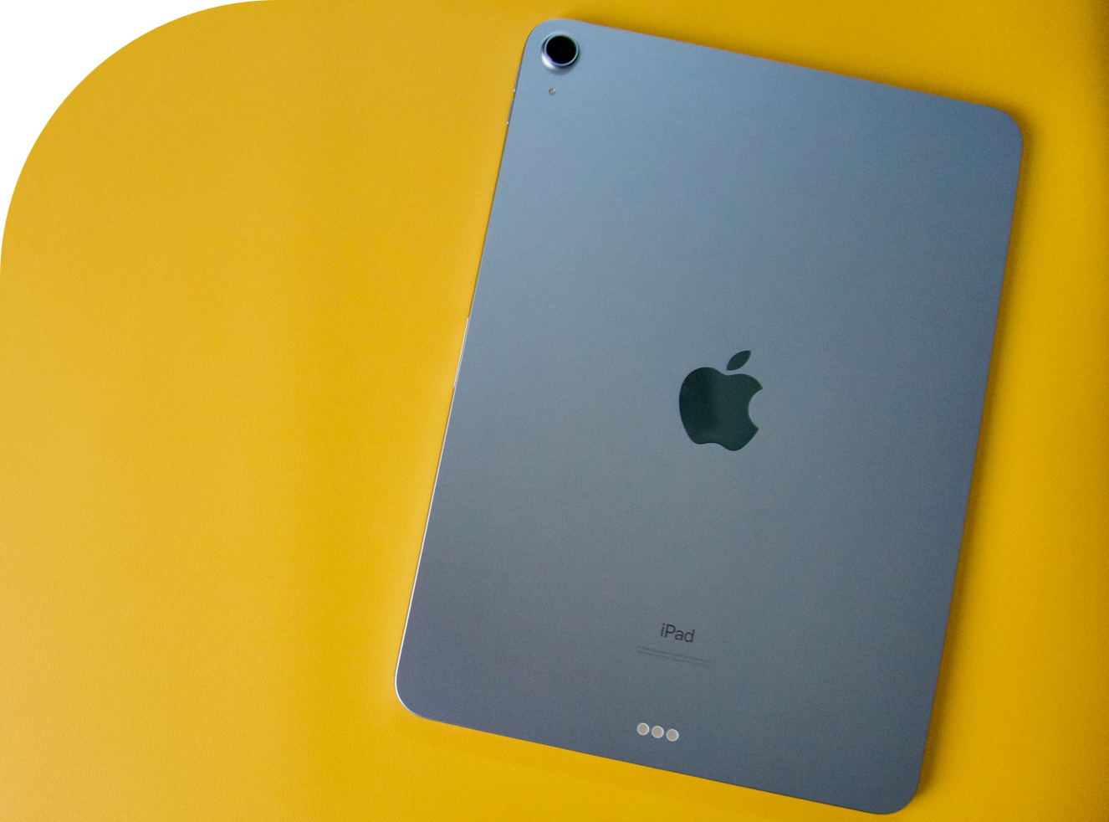
What is a tablet?
Tablet
Portable (battery, with charger)
Flat, touchscreen (no keyboard or mouse/trackpad)

Slide 8
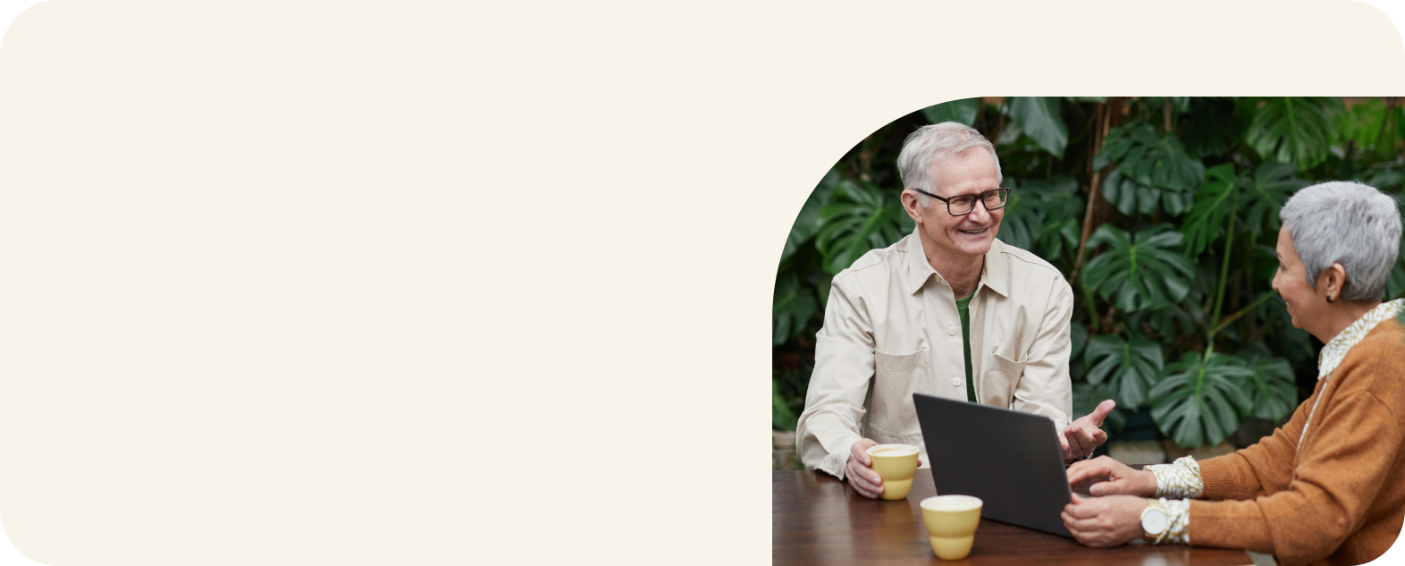
Which type of device do you have?

Slide 9


Operating systems
Computer
Tablet
MacOS
Windows
iPadOS
Android

Slide 10
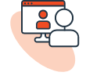





What can you do with a computer or tablet?
Stay in touch
Find information
Video call
Search for recipes, health advice, or news
Email
Check the weather
Take photos and videos
(if camera and speaker integrated)
Look up maps and directions
Social media

Slide 11
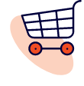




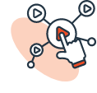


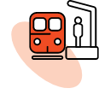
What can you do with a computer or tablet?
Practical tasks
Entertainment
Shop
Listen to music, podcasts and audiobooks
Save dates in the calendar
Play games
Banking
Watch videos
Write letters
Read e-books
Book tickets and appointments
And so much more!

Slide 12
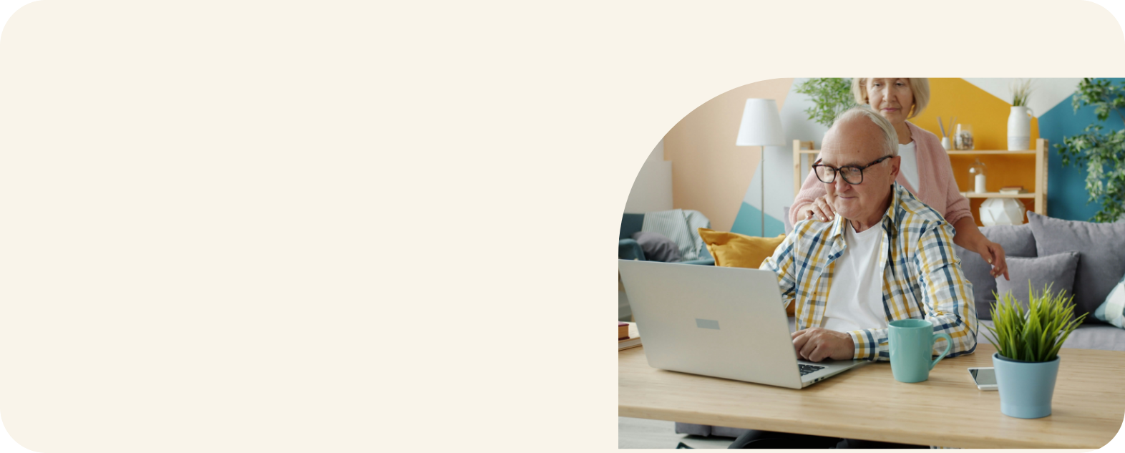
What do you currently use your device for?

Slide 13


Connecting to the internet
Wi-Fi
Mobile data

Slide 14
Key physical features
Desktop computers
Monitor
Keyboard me, brightness, etc.
Mouse
Computer box
Power button
Ports
Camera and speakers

Slide 15
Key physical features
Laptop computers
Screen
Keyboard
Trackpad (might have buttons)
Power button
Ports
Camera and speakers

Slide 16
Key physical features
Tablets
Touchscreen
Power button
Volume buttons
Front and rear cameras and speakers
Port/s

Slide 17
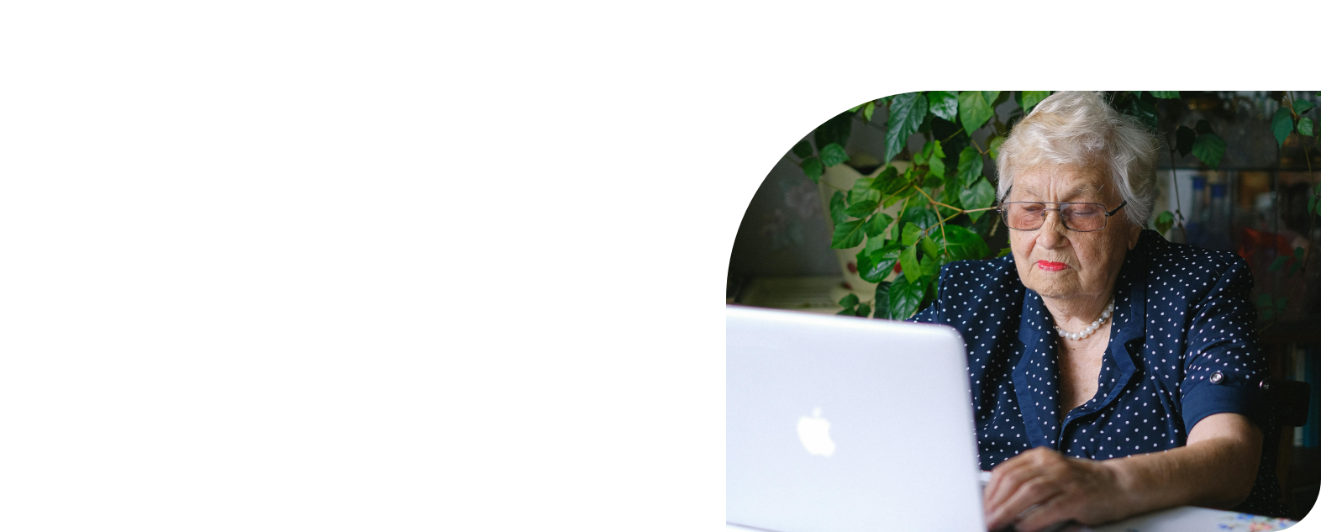
Let’s turn your device off and on
Is your passcode easy to guess?

Slide 18
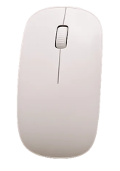
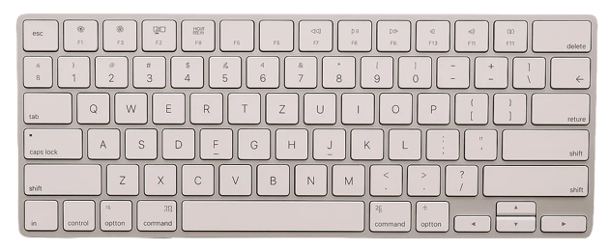
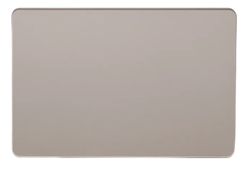
Let’s navigate on a computer
Mouse
or
Trackpad
Keyboard

Slide 19
Let’s navigate on a tablet
Tap
Touch and hold
Swipe
Scroll
Zoom in and out

Slide 20
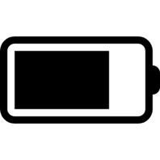




Symbols
Battery
Wi-Fi
Mobile data
Bluetooth
Volume

Slide 21
Let’s open programs and apps
Minimise
Full screen
Close

Slide 22
Let’s adjust the settings…
AA
Brightness
Text size
Volume

Slide 23
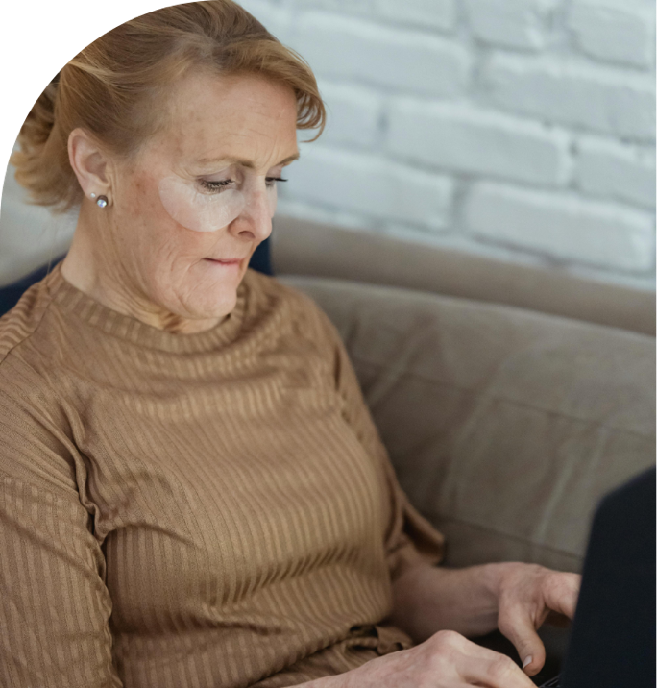
Let’s spend time on your questions from the start of the session.

Slide 24
Let’s revisit your learning
I can:
Explain what computers and tablets are and list common things they can do.
Identify key physical features.
Turn my computer or tablet on/off and unlock it.
Navigate using basic gestures (tablet) or mouse/trackpad and keyboard (computer).
Adjust basic settings like brightness, text size and volume.

Slide 25

What’s your key takeaway?

Slide 26

What three things will you try in the next week?

Slide 27
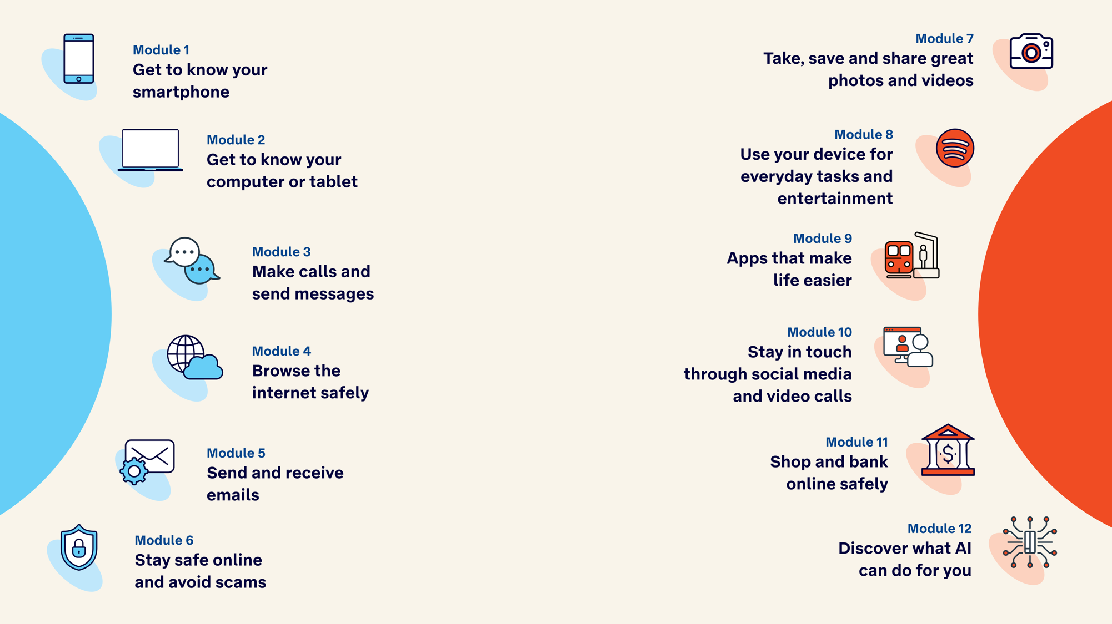
Tech Savvy
Seniors

