Slide 1



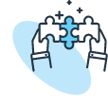



Tech Savvy Seniors Module 2: Get to know your computer or tablet
My notes
I can:
Explain what computers and tablets are and list common things they can do.
Identify key physical features.
Turn my computer or tablet on/off and unlock it.
Navigate using basic gestures (tablet) or mouse/trackpad and keyboard (computer).
Adjust basic settings like brightness, font size and volume.
Key takeaways
My key insights from today are:
Support
I can get support from:
My action plan
In the next week, I will:
1
2
3

Slide 2

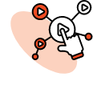

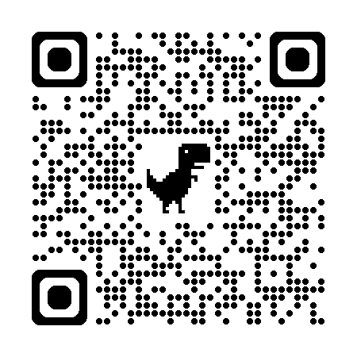
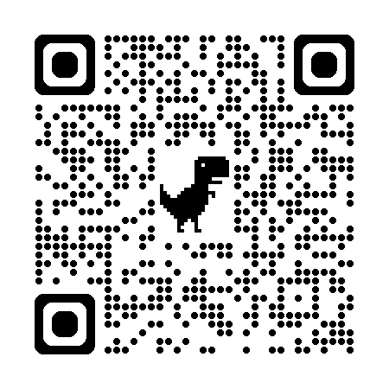
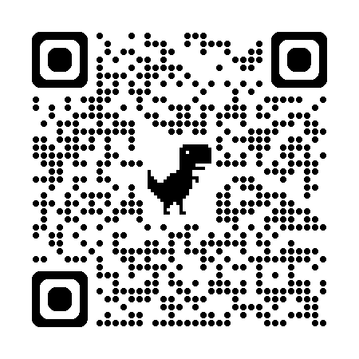
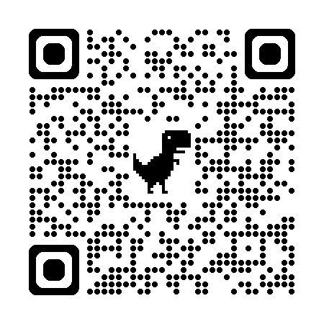
Tech Savvy Seniors Module 2: Get to know your computer or tablet
What is a computer or tablet?
Computers can be:
Desktop – large monitor, keyboard, mouse, and computer box (usually kept on a desk at home).
Laptop – smaller and portable, folds open like a book, with screen, keyboard and trackpad all in one.
Tablets – light and portable, controlled by tapping and swiping the screen with your fingers (e.g. iPad or Samsung tablet).
There are different operating systems: Apple macOS for Macs, Microsoft Windows for other computers, Apple iPadOS for iPads, and Google Android for all other tablets.
Use your computer/tablet to:
Stay in touch: emails, video calls, share photos, social media.
Find information: news, recipes, health info, maps, weather.
Entertainment: YouTube, TV, music, podcasts, games, eBooks.
Practical tasks: shopping, banking, writing, calendars, notes.
Apps and programs
Apps and programs are the tools that let your device do different jobs (e.g. internet, weather, music).
On a computer, programs are usually opened from the Start menu (Windows) or Dock (Mac).
On a tablet, apps are opened by tapping their icon on the Home screen. To see all apps, swipe up from the bottom of the screen to open the App Drawer.
Turn computer/tablet off/on and unlock it
Turn on and off: Hold the power button. Once turned on, the device will stay on. It will go to ‘sleep’ (screen will go black) when not in use.
Unlocking: Tap a button or the screen to wake it up. For security, your device automatically locks and must be unlocked with a passcode.
Navigate
On a computer:
Mouse (desktop):
Move it to move pointer/cursor on screen.
Left-click (or double-click) to select.
Right-click for more options.
Scroll wheel to move up/down a page.
Trackpad (laptop):
Slide finger to move pointer/cursor.
Tap or click to select.
Two-finger scroll to move up/down a page.
Keyboard:
Enter/Return to confirm or add a new line.
Backspace/Delete to erase text.
On a tablet:
Tap to select.
Touch and hold: Hold your finger on the screen to move apps.
Scroll: Slide your finger up and down.
Swipe: Slide your finger left and right to turn pages/screens.
Zoom: Place two fingers on the display and move them apart or pinch them together to zoom in and out.
User guides
Scan the QR codes (with your camera) or select the links.
Windows computers
Mac computers
Android tablets
iPads

