Slide 1
Discover what AI can do for you
Tech Savvy Seniors
Module 12

Slide 2

Acknowledgement of Country
We recognise and acknowledge the existing, original, and ancient connection Aboriginal and Torres Strait Islander peoples have to the lands, waterways, and sky country across the Australian continent. We pay our respects to their Elders past and present.
Artwork: 'Connection' by Bobbi Lockyer.

Slide 3




Learning outcomes
By the end of this session, you’ll be able to:
Explain what artificial intelligence (AI) means in simple terms.
Identify examples of AI in apps and everyday tasks.
Use a voice assistant and chatbot to ask a question.
Explain AI risks and safety tips.

Slide 4

Has anyone heard of the term AI or artificial intelligence? What do you know about it?

Slide 5

What’s one thing you’d like to feel more confident about by the end of today?

Slide 6
What is AI?
AI is the ability of a computer system to perform tasks that would normally require human intelligence, such as learning, reasoning, and making decisions.

Slide 7

When you hear the word ‘AI’, what comes to mind?

Slide 8
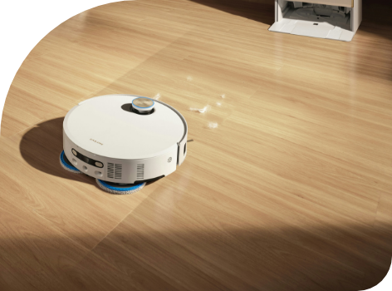
Everyday examples of AI
Facial recognition
Predictive text or autocorrect
Google Search suggestions
Voice assistants
Navigation apps
Streaming suggestions
Online shopping recommendations
Robotic vacuums
Chatbots

Slide 9
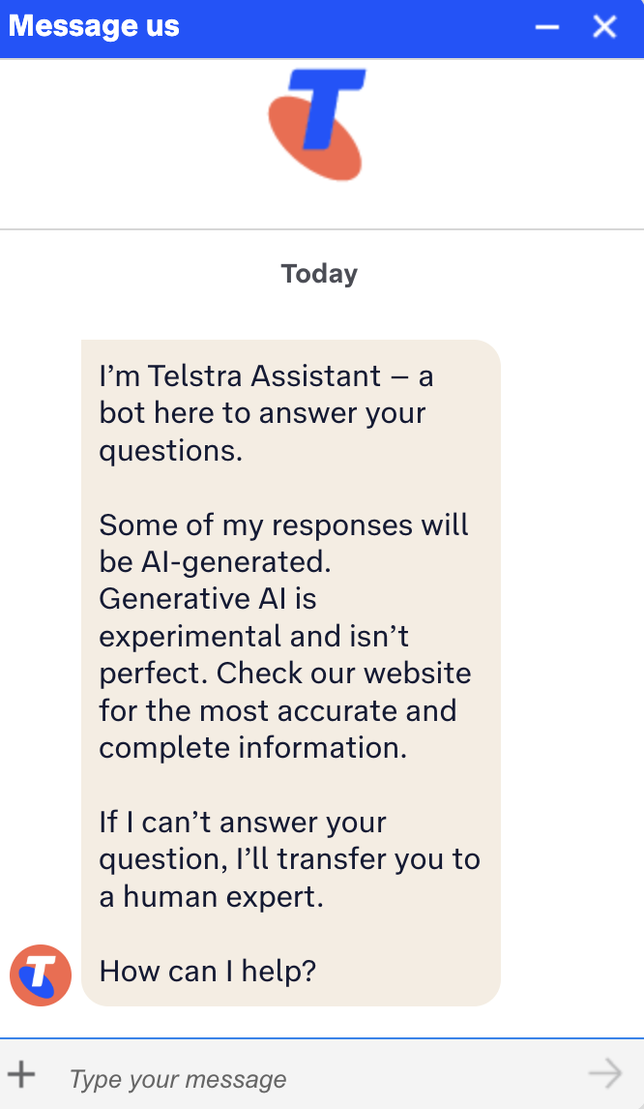
Let’s look at Telstra’s chatbot
Notes:
https://www.telstra.com.au/chatnow/landing

Slide 10

Have you seen any of these in action before? Which ones do you already use, even if you didn’t realise they were AI? Which do you think would be most useful to you?

Slide 11
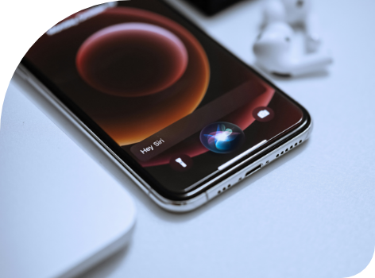
Voice assistants
Most smartphones and tablets come with a built-in voice assistant:
Google Assistant/Gemini (Android)
Siri (Apple)
You can also buy home-based voice assistants like Google Nest or Amazon Alexa
Voice assistants can answer questions
They can also do simple tasks, depending on the devices they’re connected to (phone, lights, TV)

Slide 12

Chatbots
ChatGPT is a popular example
You can type a question or prompt, and it will reply in plain English
These tools are very powerful, but they don’t always get things right — so always check important information elsewhere

Slide 13
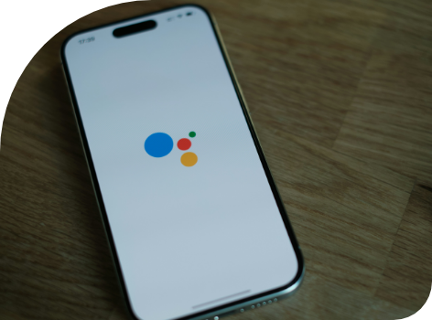
AI risks
Chatbots and voice assistants might sound confident, but sometimes they:
Get facts wrong or leave out important details
Make things up or “hallucinate” answers
Repeat common mistakes they’ve seen online
Try to please you. That means they might give an answer just because they think you want one, even if it’s not fully correct

Slide 14

CSIRO - AI Explained: It's maths, not magic (a simple guide)
Notes:
https://www.youtube.com/watch?v=5mHxO2JpCR0

Slide 15

Tips
Don’t share private or sensitive information with chatbots or voice assistants
Use common sense — if something seems wrong or odd, don’t rely on it.
Be cautious of advice around health, money or legal issues — always ask a trusted source or professional.
AI can reflect the biases or mistakes in the information it’s trained on — it’s not always neutral or fair.

Slide 16

Let’s spend time on your questions from the start of the session.

Slide 17
Learning outcomes
I can:
Explain what artificial intelligence (AI) means in simple terms.
Identify examples of AI in apps and everyday tasks.
Use a voice assistant and chatbot to ask a question.
Explain AI risks and safety tips.

Slide 18

What’s your key takeaway?

Slide 19

What three things will you try in the next week?

Slide 20
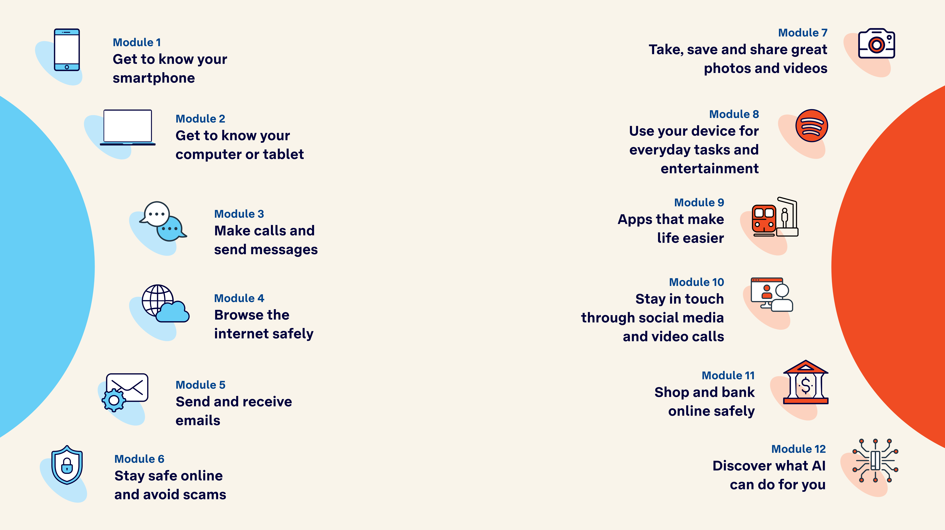
Tech Savvy
Seniors

