Slide 1

Shop and bank online safely
Tech Savvy Seniors
Module 11

Slide 2

Acknowledgement of Country
We recognise and acknowledge the existing, original, and ancient connection Aboriginal and Torres Strait Islander peoples have to the lands, waterways, and sky country across the Australian continent. We pay our respects to their Elders past and present.
Artwork: 'Connection' by Bobbi Lockyer.

Slide 3




Learning outcomes
By the end of this session, you’ll be able to:
Navigate online shops and search for items.
Explain what makes a payment method or page secure.
Recognise signs of a scam or fake store.
Access online banking safely (view only).

Slide 4

Have you ever tried shopping online?

Slide 5

Have you ever used internet banking?

Slide 6

What’s one thing you’d like to feel more confident about by the end of today?

Slide 7

Shopping online
Browsing a shop’s catalogue
Checking what’s in stock
Looking up product information
Reading customer reviews
Comparing prices
Placing an order for delivery or ‘click and collect’ (pick up instore)

Slide 8

What shops do you think you might find online?

Slide 9

Can you think of a time when online shopping might save time, effort or money?

Slide 10

Safe online stores
A safe store usually has:
A padlock icon in the address bar
A web address starting with https:// (the ‘s’ means secure)
The correct name of the shop in the website address
Clear payment options — like credit/debit card or PayPal
An ABN
Visible customer service or contact information
A refund or return policy (usually at the bottom of the page)

Slide 11

Red flags
Prices that seem too good to be true
Poor spelling or grammar on the site
No phone number, physical address or contact email
Pressure to act quickly or limited time offers
Asking for unusual payment methods, like direct bank transfer
Links in emails or texts that ask you to enter passwords or account details
Low resolution images

Slide 12




Source: https://www.scamwatch.gov.au/stop-check-protect

Slide 13
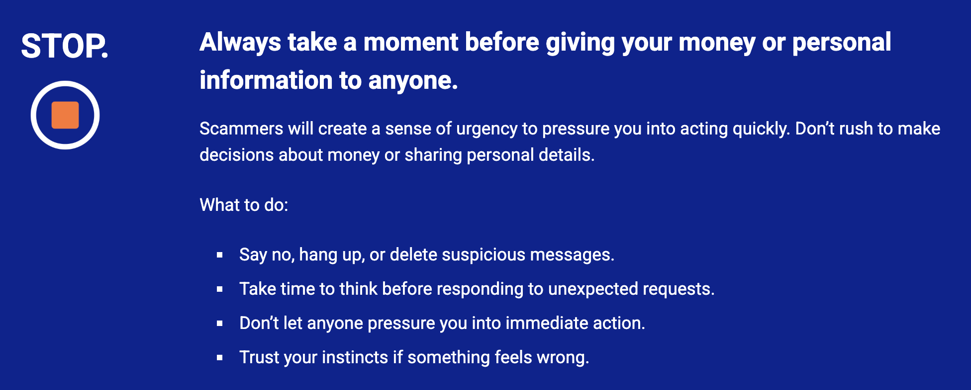

Slide 14
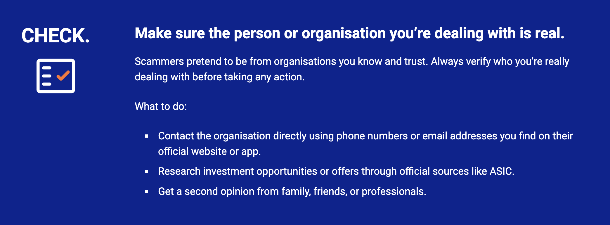

Slide 15
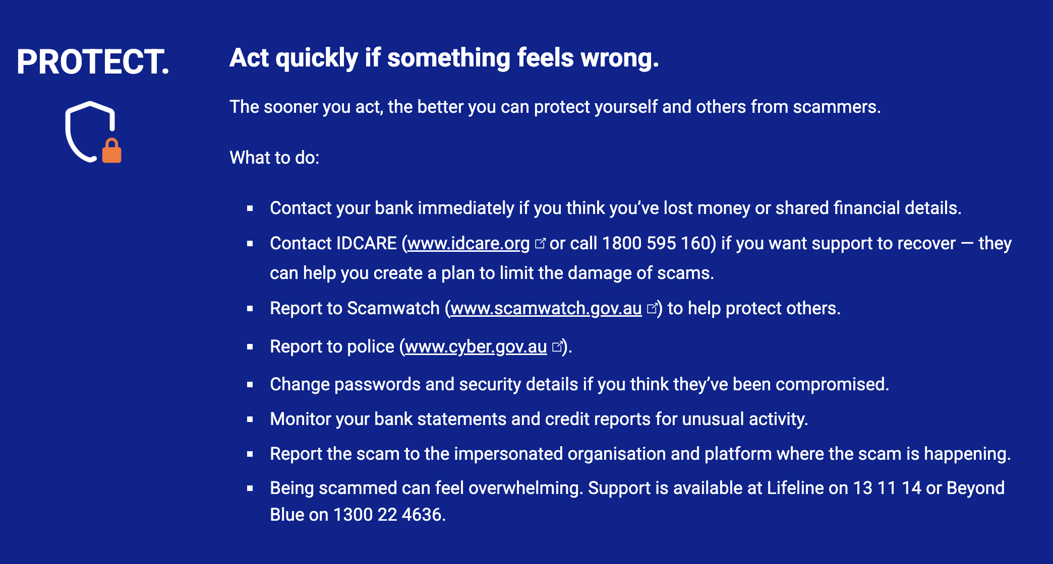

Slide 16

Online banking
Check your balance
View recent transactions
Pay a bill
Transfer money between accounts or to someone you know
Change card settings

Slide 17
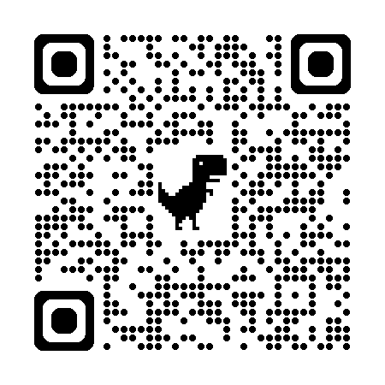
Bendigo Bank’s e-banking demo

Slide 18

Safety tips
Only use your bank’s official website or app.
Don’t use public Wi-Fi for banking.
Use a strong, unique password — don’t share it or reuse it elsewhere.
Always log out when finished and close the app or browser.
Turn on two-factor authentication if your bank offers it.
Check your account often and report anything suspicious to your bank.

Slide 19
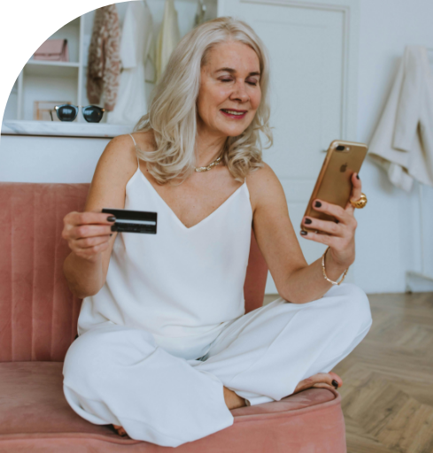
Let’s spend time on your questions from the start of the session.

Slide 20
Learning outcomes
I can:
Navigate online shops and search for items.
Explain what makes a payment method or page secure.
Recognise signs of a scam or fake store.
Access online banking safely (view only).

Slide 21

What’s your key takeaway?

Slide 22

What three things will you try in the next week?

Slide 23
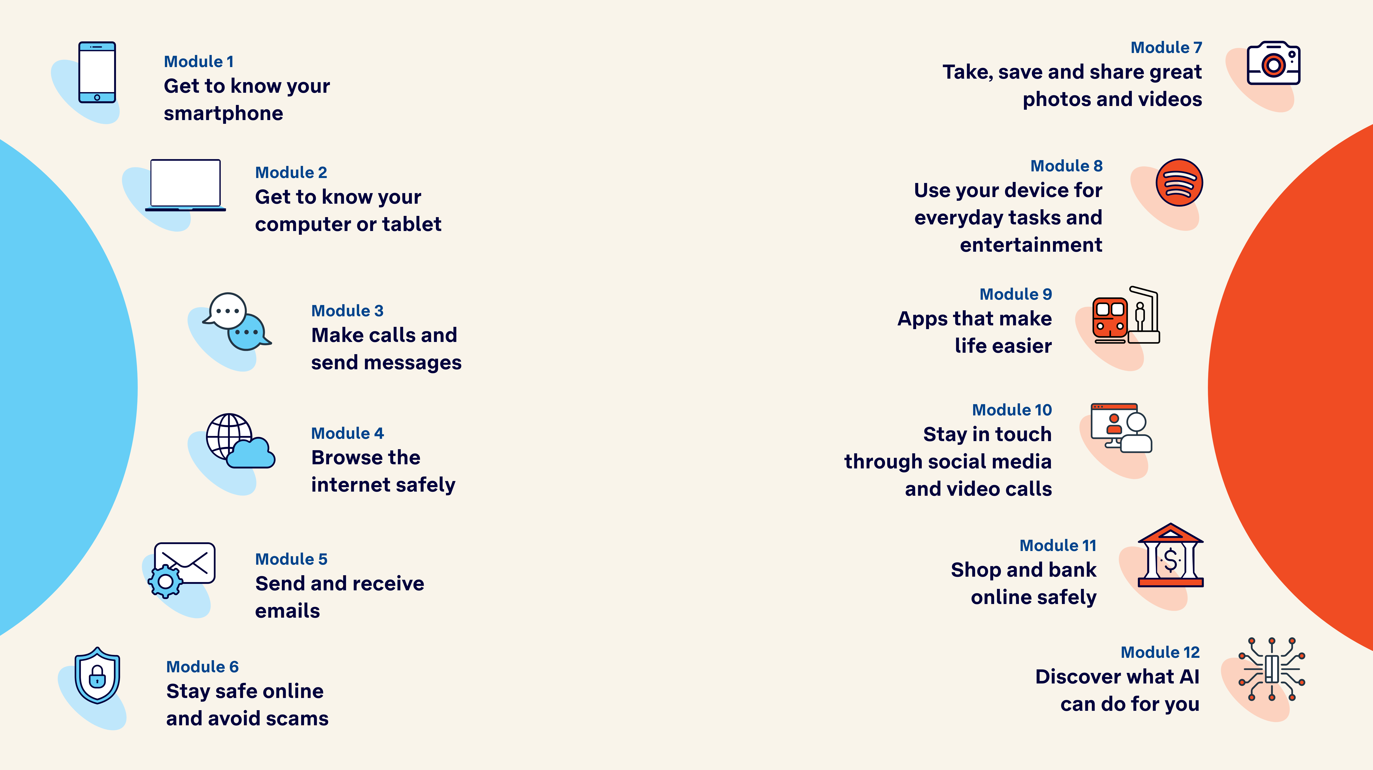
Tech Savvy
Seniors

