Slide 1







Tech Savvy Seniors Module 11: Shop and bank online safely
My notes
I can:
Navigate online shops and search for items.
Explain what makes a payment method or page secure.
Recognise signs of a scam or fake store.
Access online banking safely (view only).
Key takeaways
My key insights from today are:
Support
I can get support from:
My action plan
In the next week, I will:
1
2
3

Slide 2



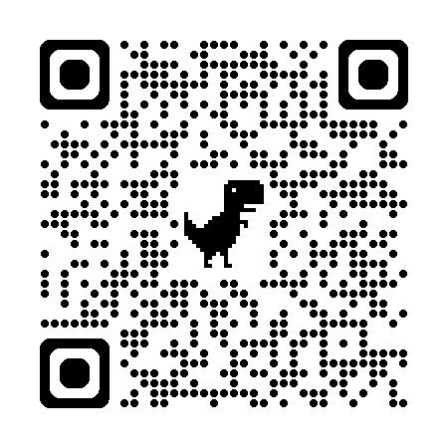
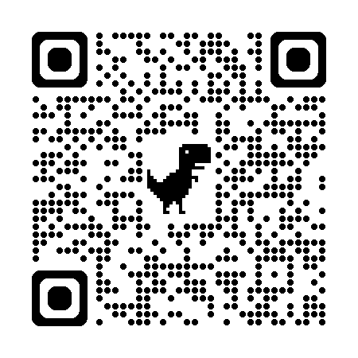
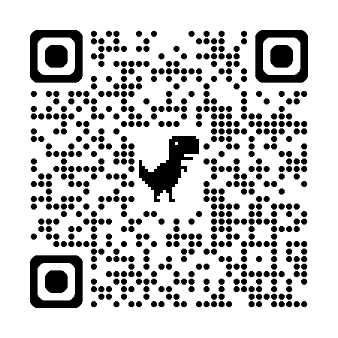
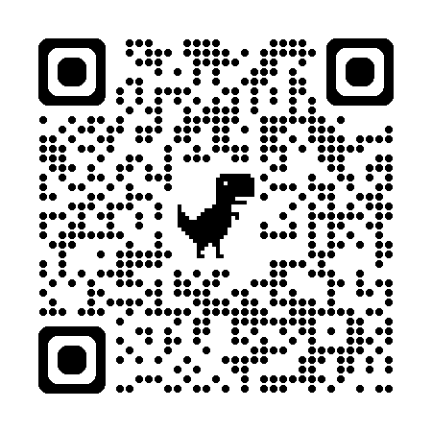
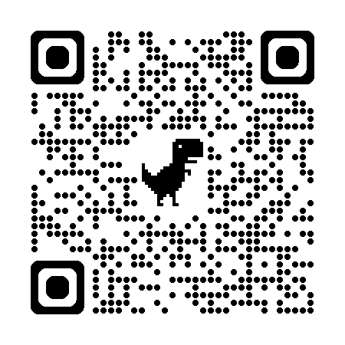
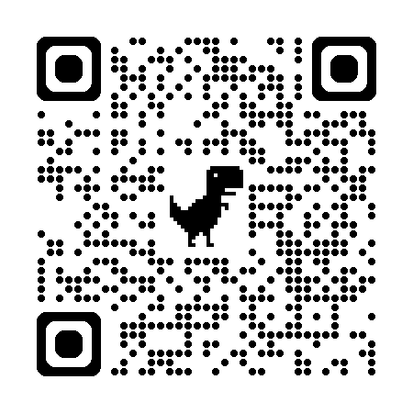
Tech Savvy Seniors Module 11: Shop and bank online safely
User guide
Scan the QR codes (with your camera) or select the links.
Scamwatch
Stop. Check. Protect.
Bendigo Bank eBanking demo
NAB
Manage your banking online
ANZ
Internet banking
CommBank
NetBank
Westpac
Online banking
Shopping online
Online shopping lets you browse and buy items (like groceries, clothes, gifts or appliances) using the internet, and either:
Have them delivered to your home, or
Pick them up at a nearby store (click & collect)
How to shop online
Find a product
If you want to shop from a particular store, you can go directly to their website or download their app (if available).
Alternatively, you can use to search engine like Google to look up a product, then tap the Shopping tab to compare prices at different stores.
Purchase a product
Add items to a virtual cart (just like in a real store)
Tap View Cart to check what you've chosen
Tap Checkout to enter your delivery details and pay
Staying safe
When shopping online, look for these signs that the website is trustworthy:
A padlock icon in the address bar
A web address starting with https:// (the ‘s’ means secure)
The correct name of the shop in the website address
An ABN (check it on ABN Lookup (business.gov.au))
Clear payment options, like credit/debit car and PayPal
Visible customer service or contact information
A refund or return policy (usually at the bottom of the page)
Online banking
Online banking means accessing your bank account on a website or app so you can:
Check your balance
View past payments
Transfer money
Pay bills (e.g. electricity, phone)
To start:
You’ll need to register with your bank (online, by phone or in a branch)
You’ll be given a Customer ID or User Number
You’ll create a secure password (don’t share it)
Your bank may send a security code to your mobile when you log in.
Staying safe
Only use your bank’s official website or app
Use a strong, unique password — don’t share it or reuse it elsewhere
Turn on two-factor authentication if your bank offers it
Don’t use public Wi-Fi for banking (like at cafés or shopping centres)
Always log out when finished and close the app or browser
Check your account often and report anything suspicious to your bank

