Slide 1
Stay in touch through social media and video calls
Tech Savvy Seniors
Module 10

Slide 2

Acknowledgement of Country
We recognise and acknowledge the existing, original, and ancient connection Aboriginal and Torres Strait Islander peoples have to the lands, waterways, and sky country across the Australian continent. We pay our respects to their Elders past and present.
Artwork: 'Connection' by Bobbi Lockyer.

Slide 3




Learning outcomes
By the end of this session, you’ll be able to:
Make a video call.
Check and use your camera and microphone during a call.
Browse a social media feed and react to a post.
Post a simple update or photo (optional).

Slide 4

Have you ever been on a video call before? What did you enjoy or find tricky?

Slide 5

Do you use social media?
If so, which one and what for?
If not, what’s stopped you?

Slide 6

What’s one thing you’d like to feel more confident about by the end of today?

Slide 7
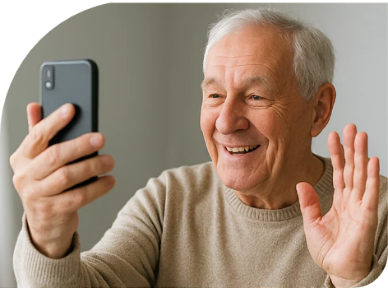
What is a video call?
A video call is like a phone call, but with video so you can see the other person..
Many people use video calls to:
Stay connected with family and friends
Attend telehealth appointments
Join hobby groups or classes from home

Slide 8





Video call apps
In-built
Downloadable
FaceTime
(iPhone/iPad)
Google Meet
(Android)
WhatsApp
Messenger
Zoom

Slide 9




Make a video call
Mute/unmute
Camera on/off
Flip camera (front/back)
Add someone to the call

Slide 10

What is social media?
A way to stay in touch online with people and share what's going on in your life
See photos, read updates, send messages, or just quietly follow along
Follow accounts based on your interests

Slide 11




Social media platforms
Facebook
Instagram
TikTok
X (formerly Twitter)

Slide 12
Let’s explore Facebook
Facebook

Slide 13
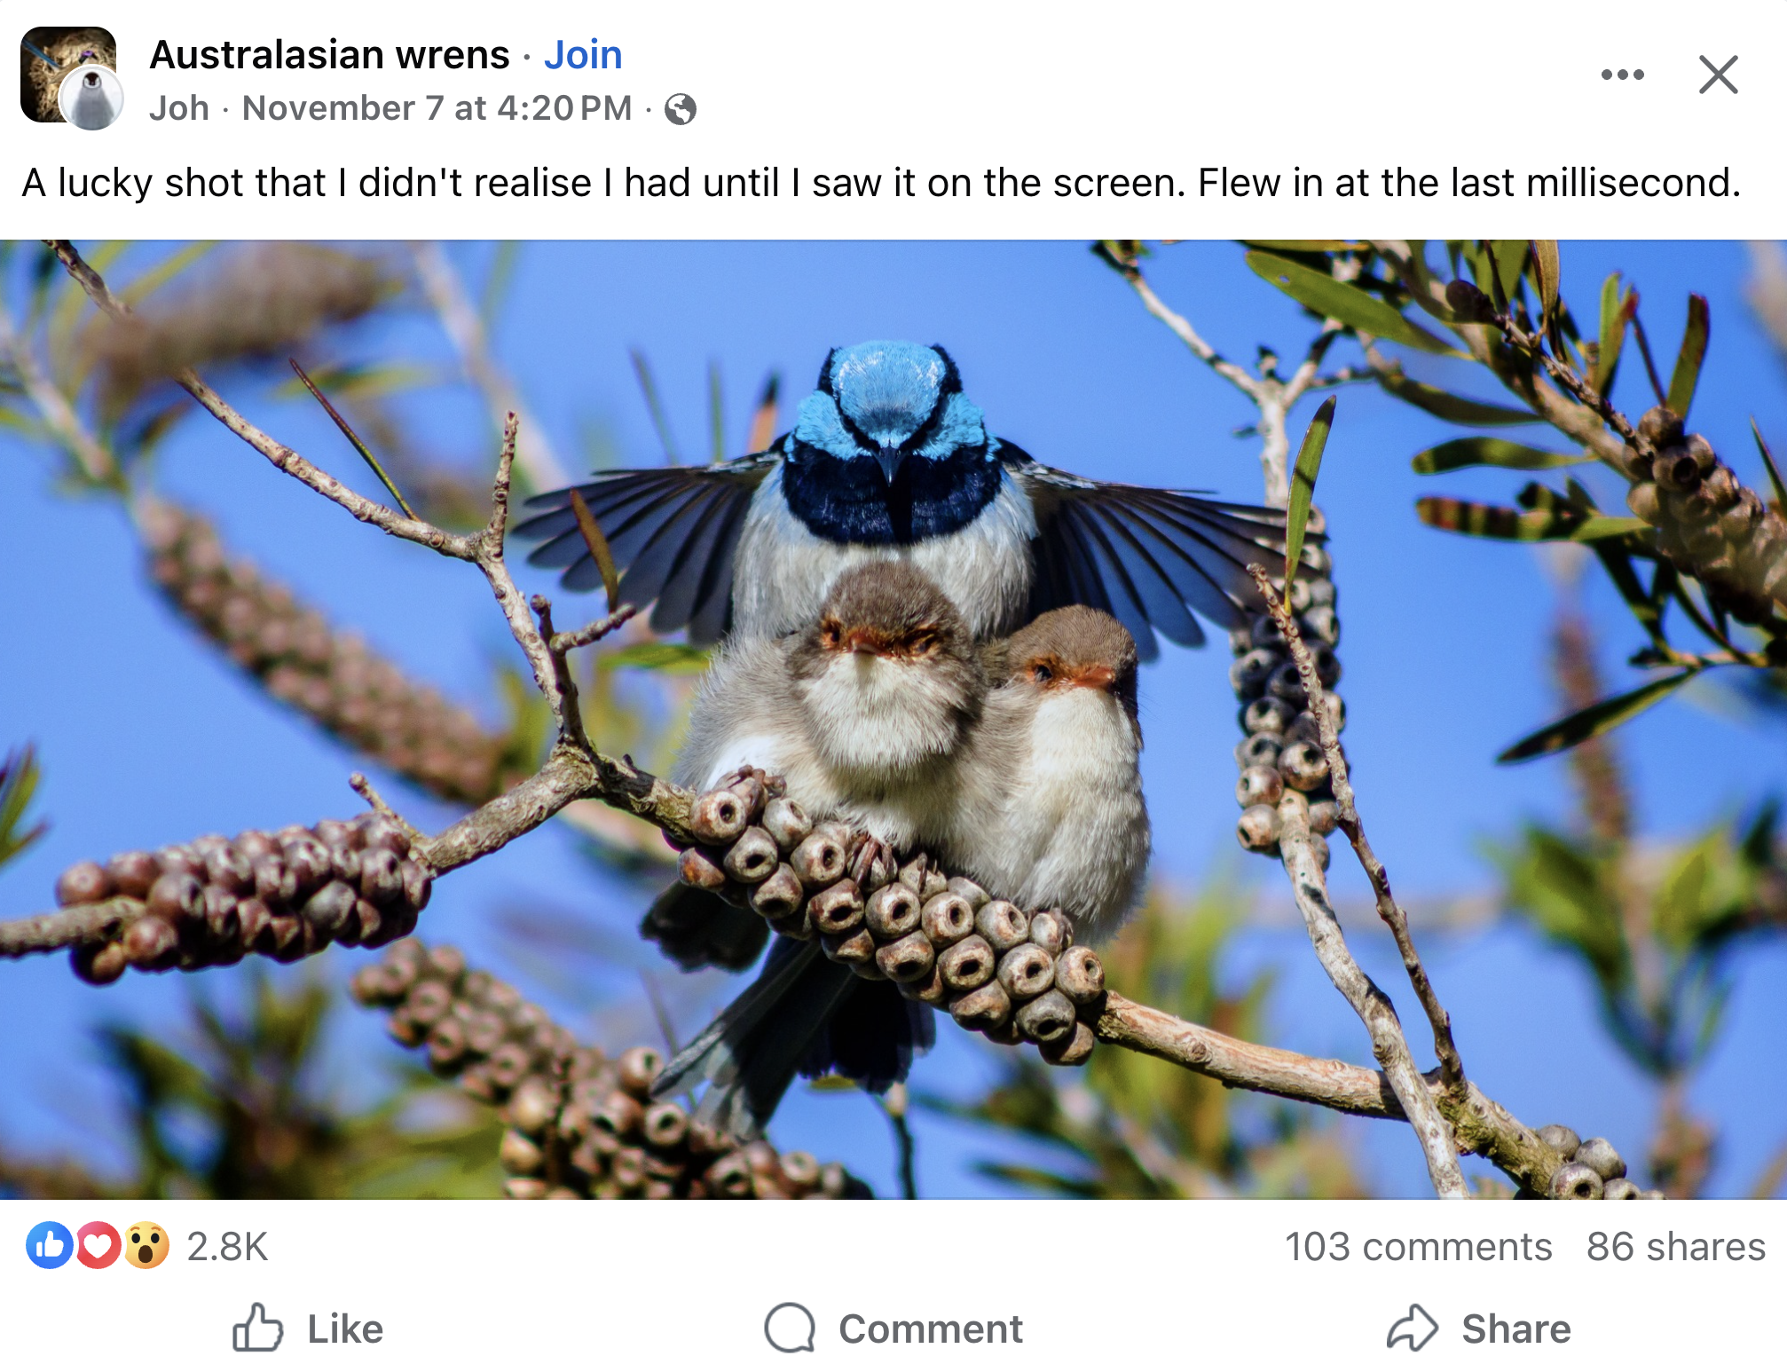
Be mindful of what you share…
Before you post or comment, pause and think:
Would I say this in person?
Could this hurt someone’s feelings?
Am I sharing something private — like someone else’s photo or personal story — without asking?
Especially with photos of children or family, always ask permission before posting.

Slide 14




Safe habits on Facebook
Only accept friend requests from people you know and trust
Avoid clicking suspicious links
Report or block anything that makes you feel uncomfortable
Log out if you're using a shared or public device

Slide 15
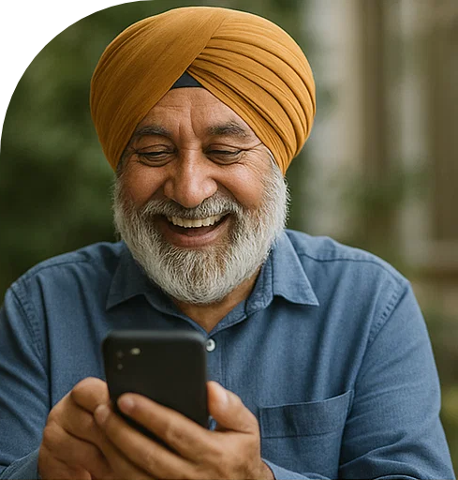
Let’s spend time on your questions from the start of the session.

Slide 16
Learning outcomes
I can:
Make a video call.
Check and use my camera and microphone during a call.
Browse a social media feed and react to a post.
Post a simple update or photo (optional).

Slide 17

What’s your key takeaway?

Slide 18

What three things will you try in the next week?

Slide 19
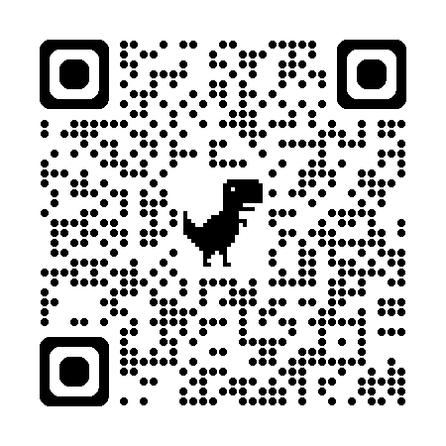
Learn more
Facebook

Slide 20
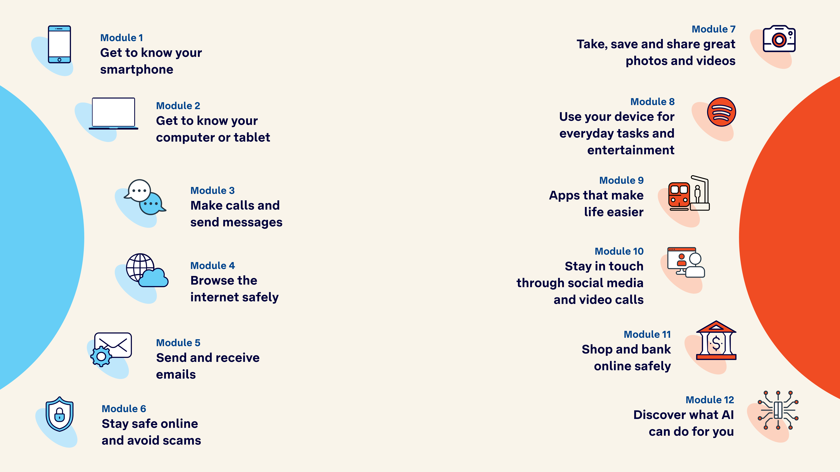
Tech Savvy
Seniors

