Slide 1

Get to know your smartphone
Tech Savvy Seniors
Module 1

Slide 2

Acknowledgement of Country
We recognise and acknowledge the existing, original, and ancient connection Aboriginal and Torres Strait Islander peoples have to the lands, waterways, and sky country across the Australian continent. We pay our respects to their Elders past and present.
Artwork: 'Connection' by Bobbi Lockyer.

Slide 3





Learning outcomes
By the end of this session, you’ll be able to:
Explain what a smartphone is and list common things it can do.
Identify your phone’s key physical features.
Turn your phone on/off and unlock it.
Navigate the home screen, open apps, and find Settings, Messages and Contacts.
Adjust basic settings like brightness, text size and volume to suit your needs.

Slide 4

What’s one thing you’d like to feel more confident about by the end of today?

Slide 5

What is a smartphone?
Apple iOS
for iPhone
Google Android
for Samsung, Google, Motorola, LG and more!

Slide 6









What can you do with a smartphone?
Call
Take photos and videos
Text
Facetime/video call
Email
Shop
Access the internet
Banking
Play games
Use public transport apps

Slide 7









What can you do with a smartphone?
Check the time
Check the weather
Set alarms and timers
Listen to music
Navigate with GPS (maps)
Watch videos
Use the calculator
Listen to podcasts and audiobooks
Save dates in the calendar
And so much more!

Slide 8

What do you currently use your phone for?

Slide 9
Mobile plans
Plans cover:
Calls (voice minutes)
Texts (SMS messages)
Data (internet)
Two types:
1. Post-paid
Include a monthly fee
Might include contract
Phone might be included
2. Pre-paid
Pay in advance

Slide 10
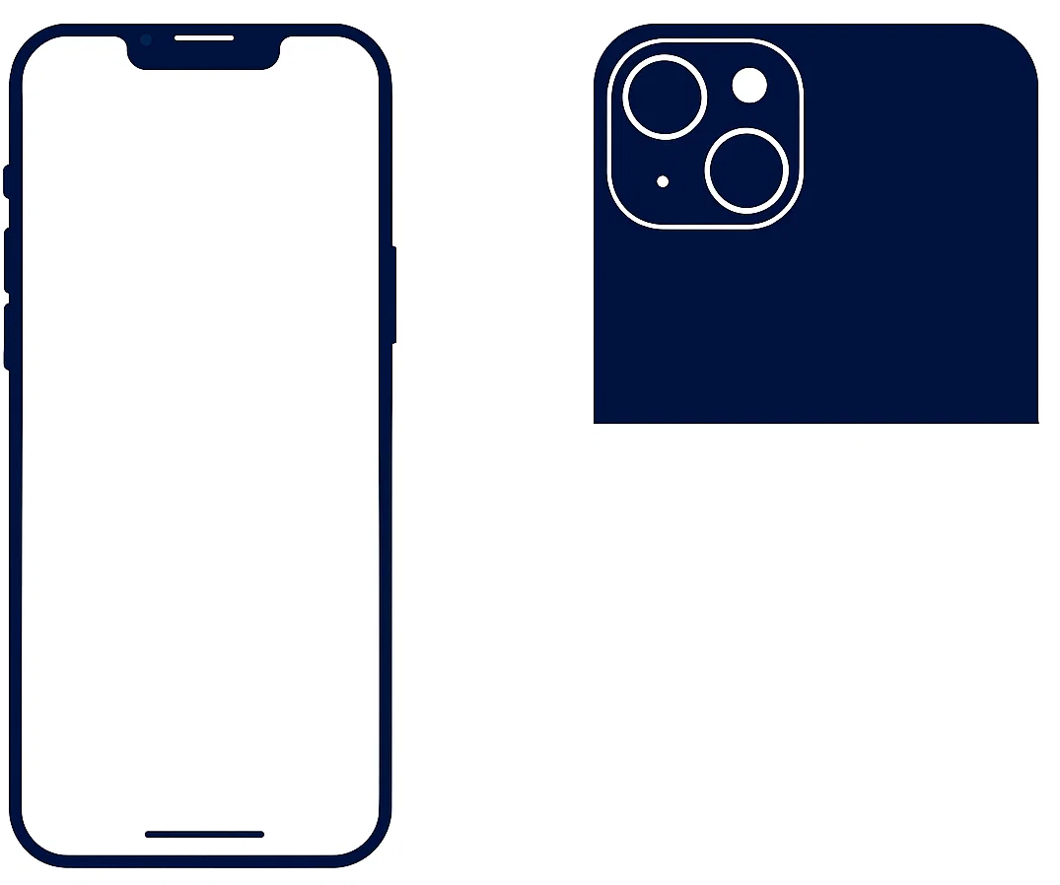
Key physical features
1
7
8
Most smartphones have these features:
Front camera
Side button
Charging port
SIM tray
Volume buttons
Ring/Silent switch
Rear cameras
Flash
6
5
2
4
3

Slide 11

Let’s turn your phone off and on
Which unlock method do you use - passcode, fingerprint, or face?

Slide 12
Let’s try these gestures…
Tap
Touch and hold
Swipe
Scroll
Zoom in and out

Slide 13






Let’s open…
Settings
Messages
Contacts

Slide 14


Virtual assistants
“Hey Siri…”
“Hey Google…”
Siri
for Apple iOS
Google Assistant
for Android

Slide 15
Let’s adjust the settings…
AA
Brightness
Text size
Volume

Slide 16

What setting did you change?

Slide 17
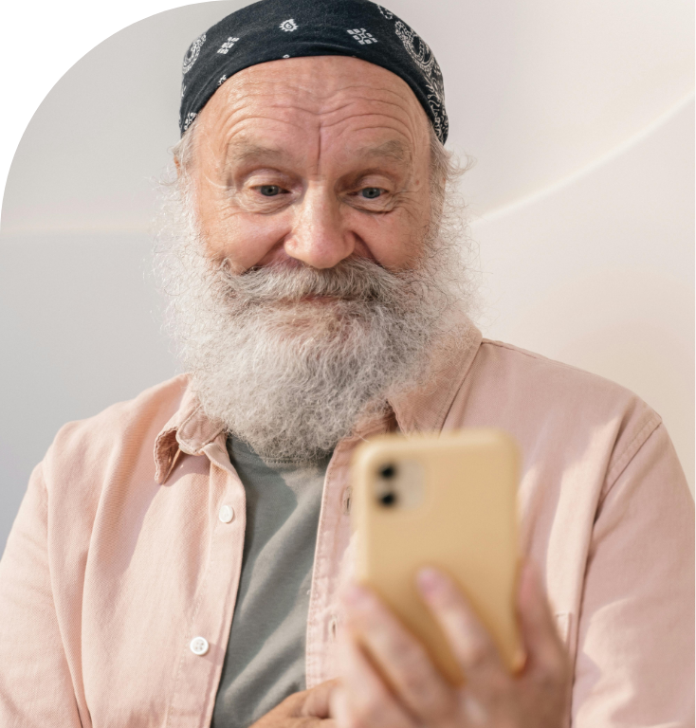
Let’s spend time on your questions from the start of the session.

Slide 18
Let’s revisit your learning
I can:
Explain what a smartphone is and list common things it can do.
Identify my phone’s key physical features.
Turn my phone on/off and unlock it.
Navigate the home screen, open apps, and find Settings, Messages and Contacts.
Adjust basic settings like brightness, text size and volume to suit my needs.

Slide 19

What’s your key takeaway?

Slide 20

What three things will you try in the next week?

Slide 21
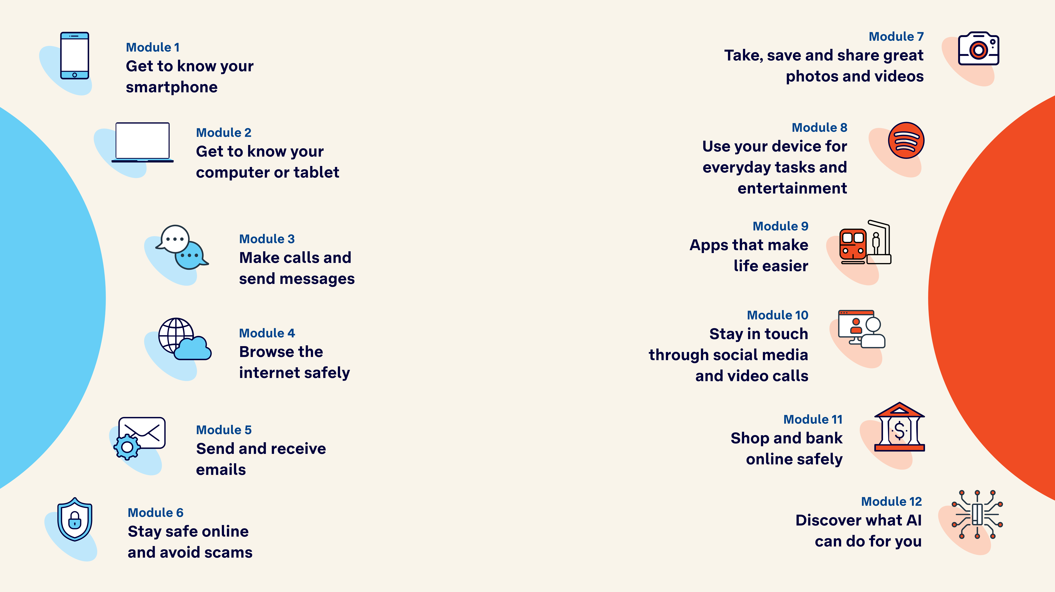
Tech Savvy
Seniors

